Slide 1
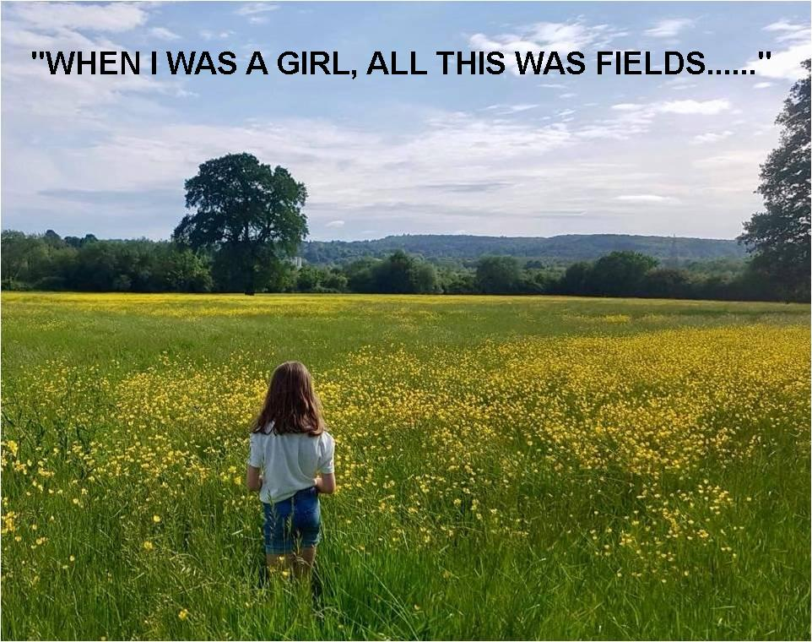

Slide 2
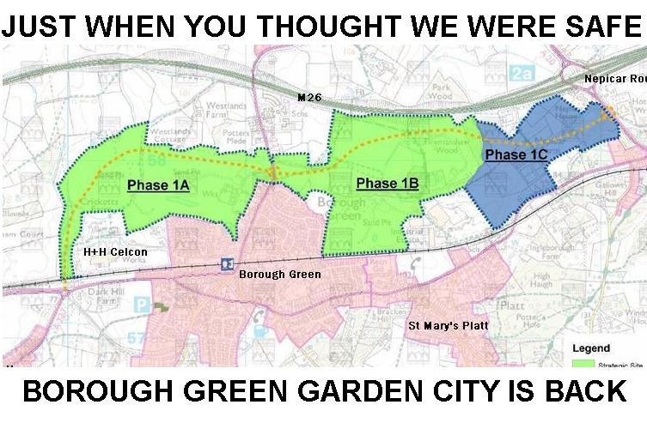

Slide 7
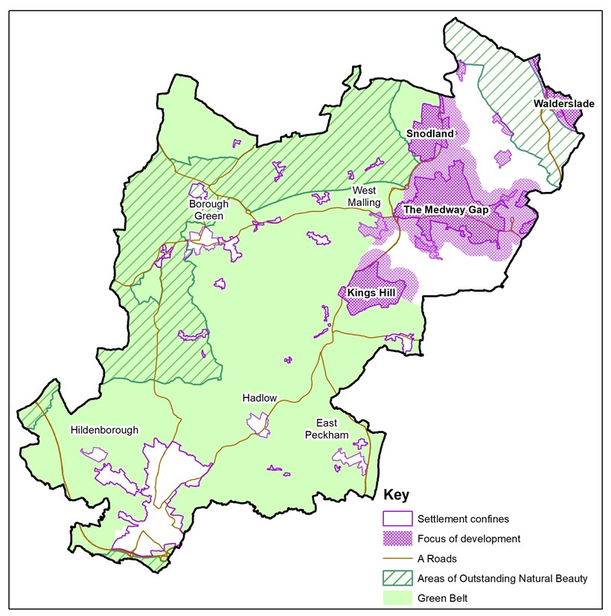

Slide 8
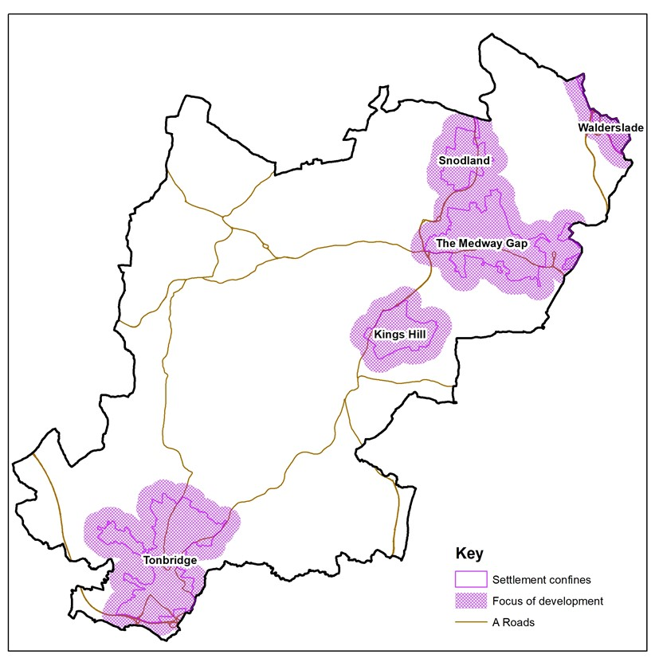

Slide 9
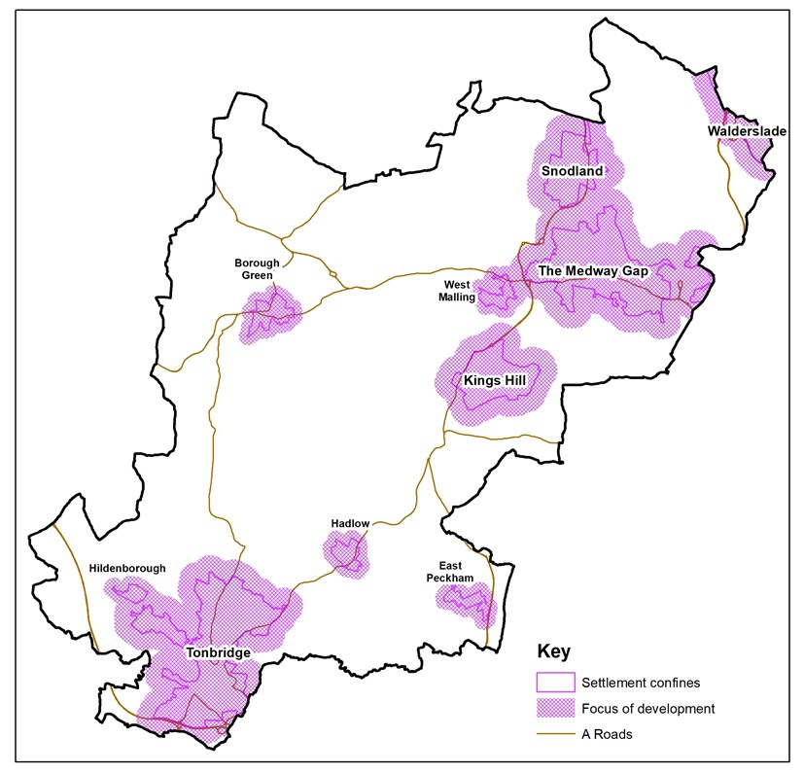

Slide 10
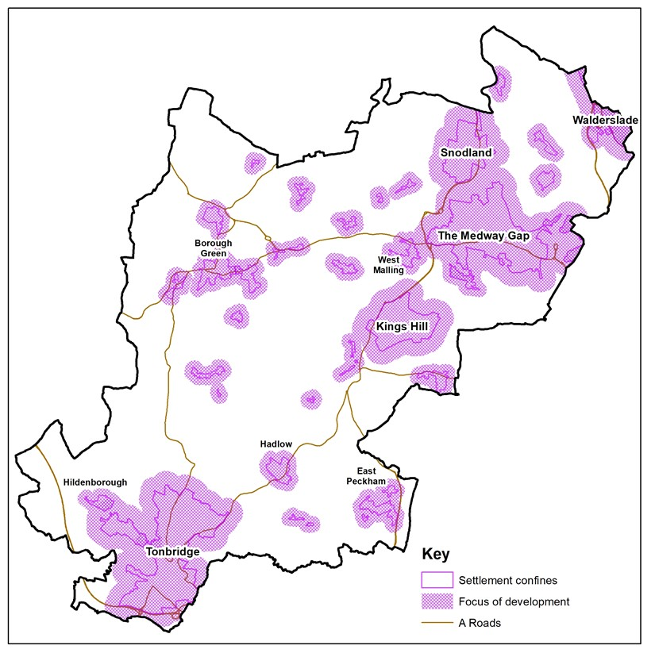

Slide 11
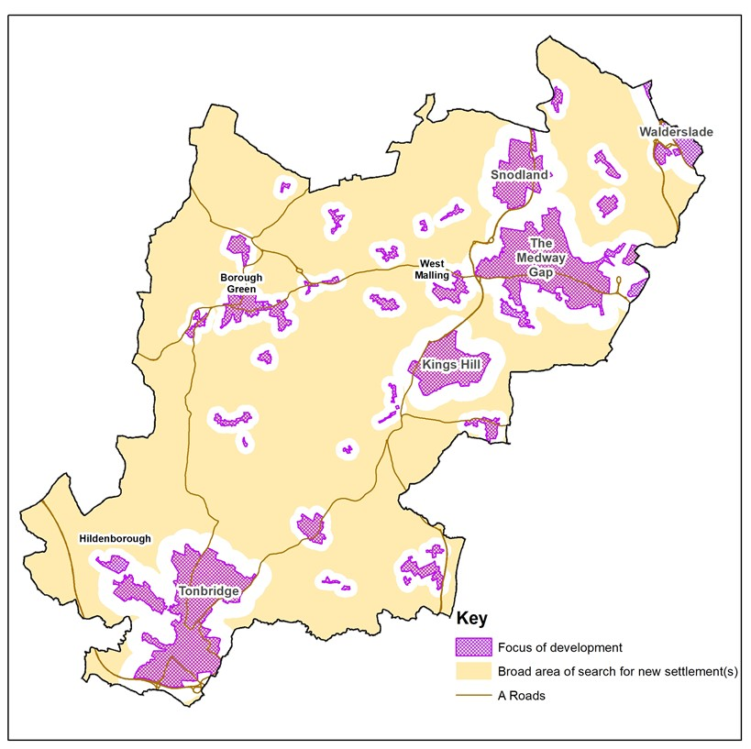

Slide 13
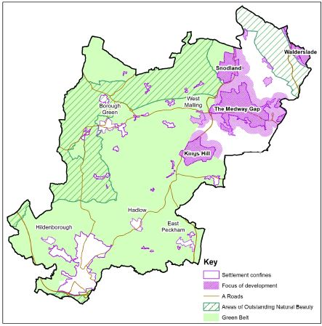

Slide 14
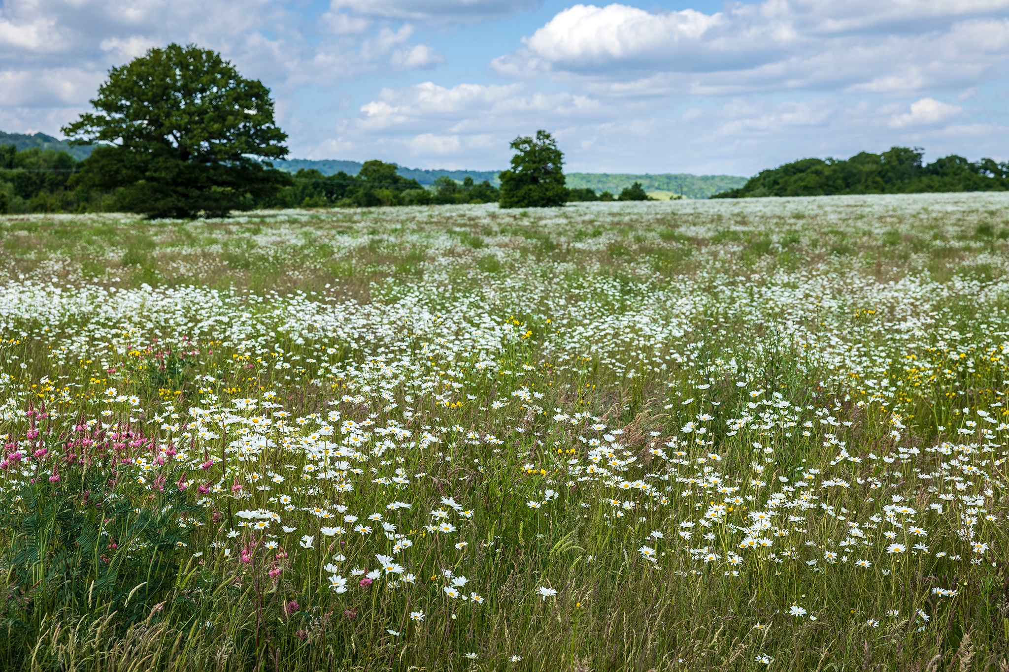

Slide 15
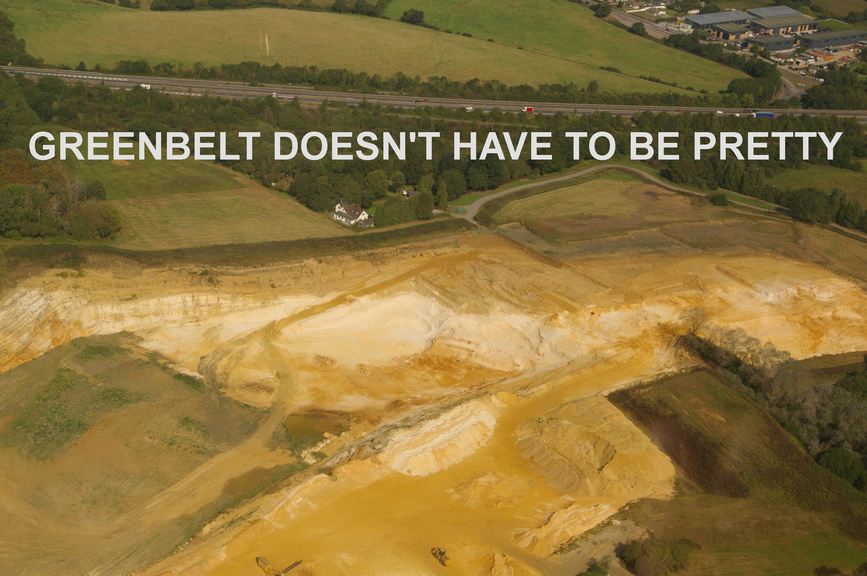

Slide 16
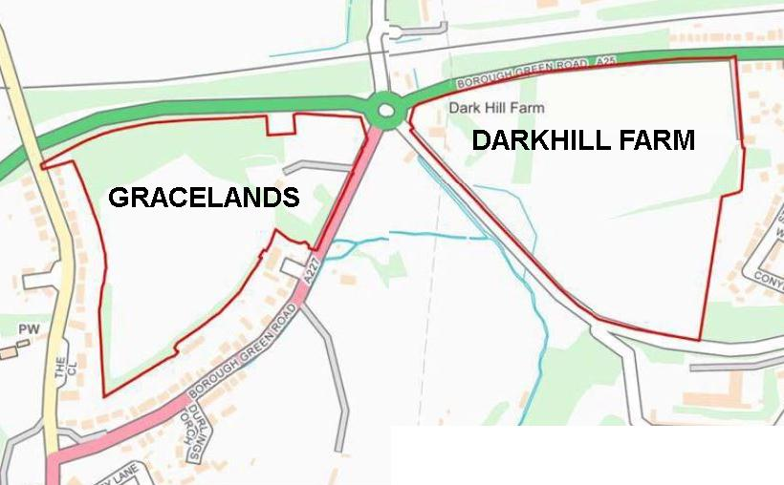

Slide 17
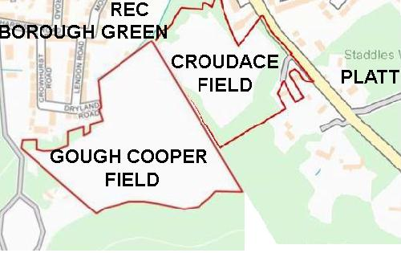

Slide 18
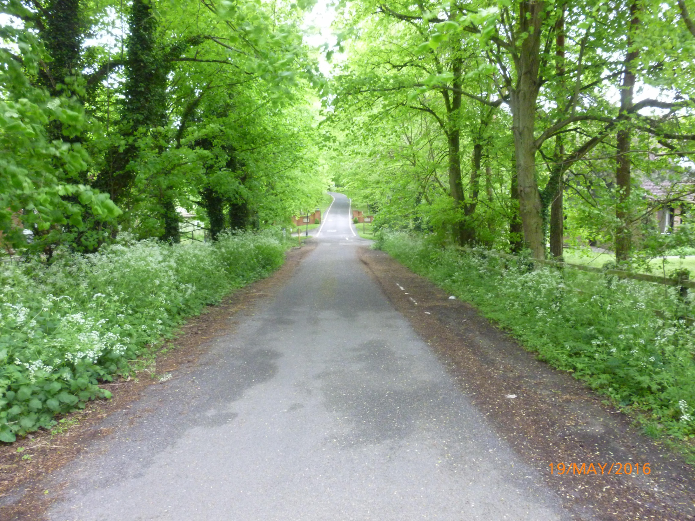

Slide 20
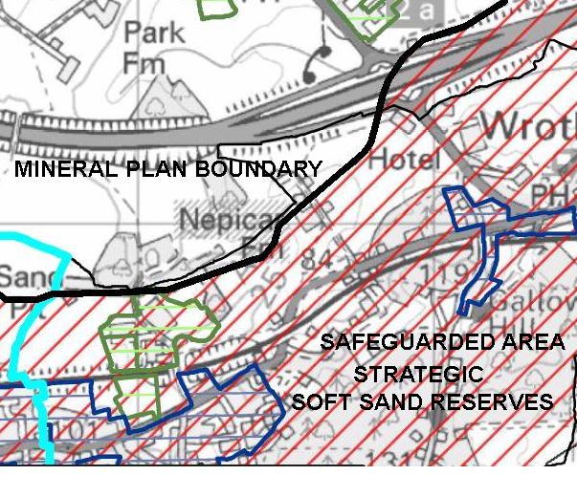

Slide 21
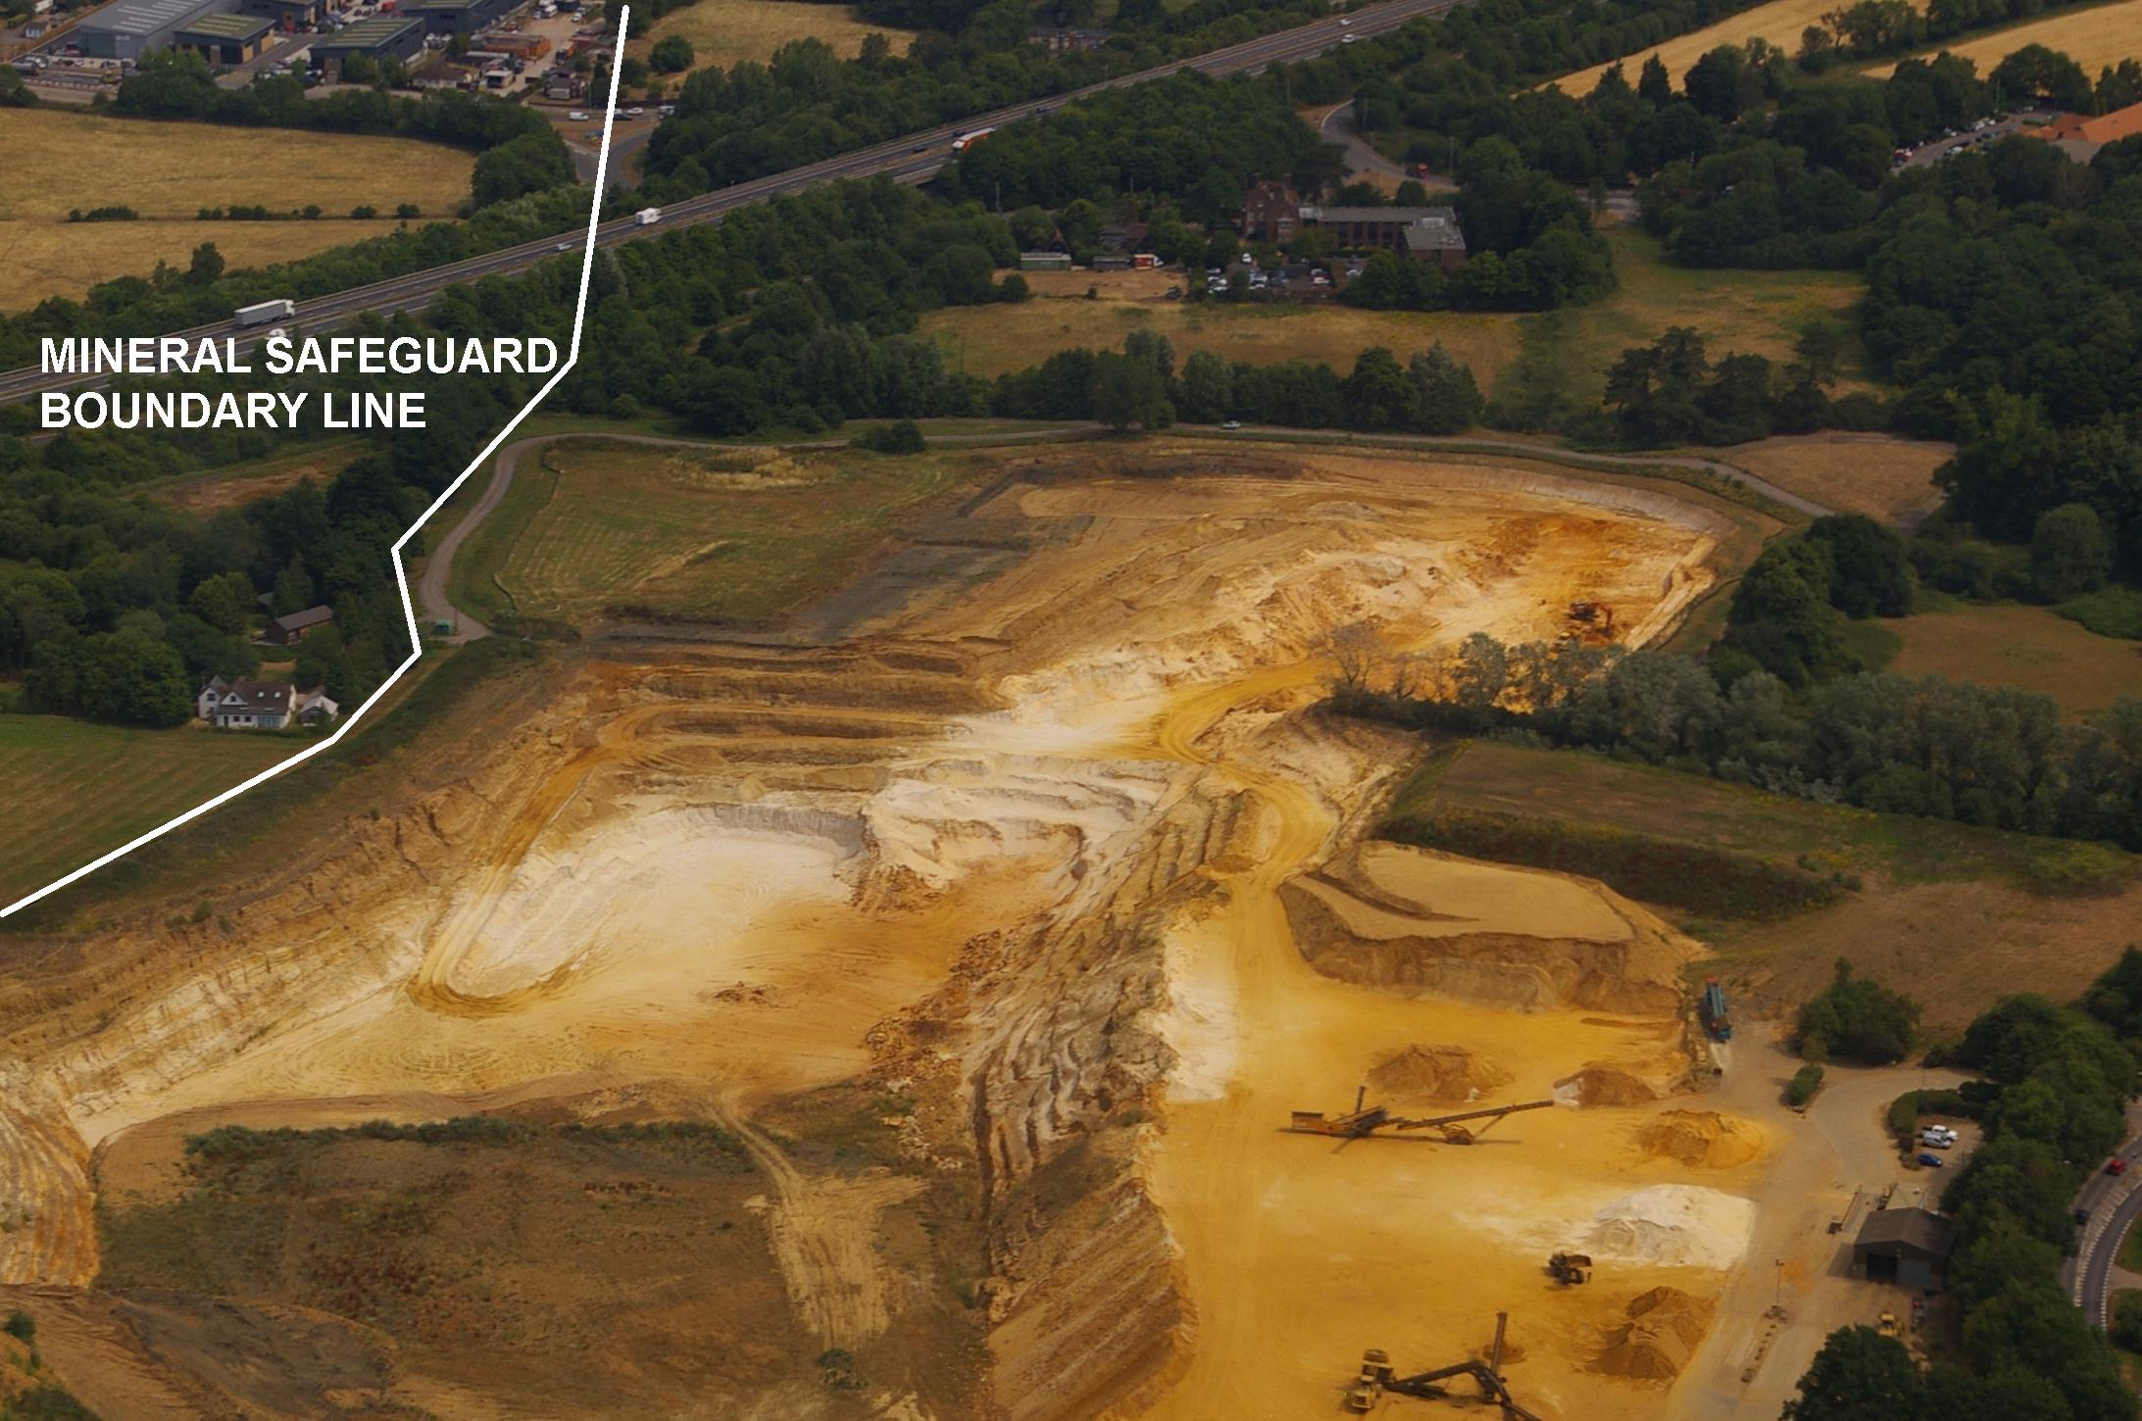

Slide 23
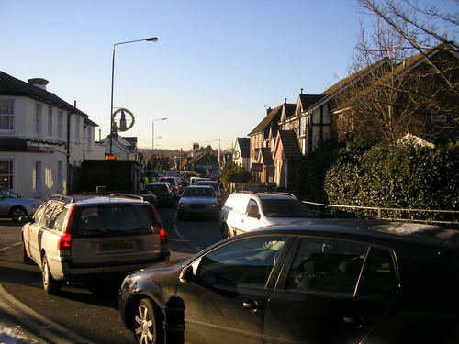

Slide 24
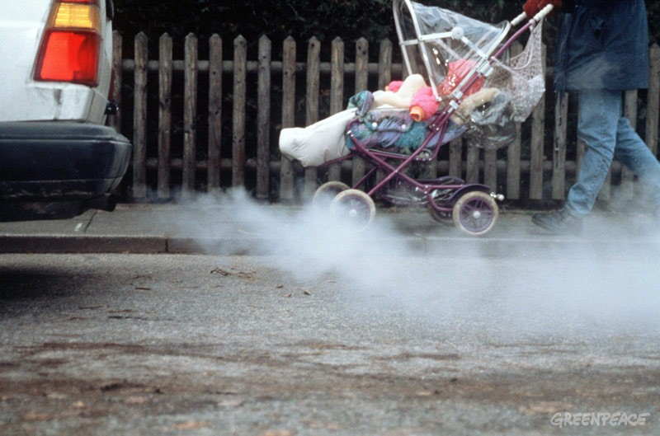

Slide 25
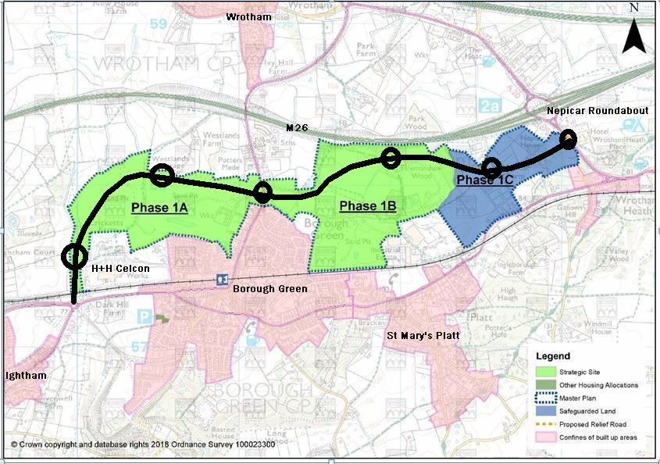

Slide 26
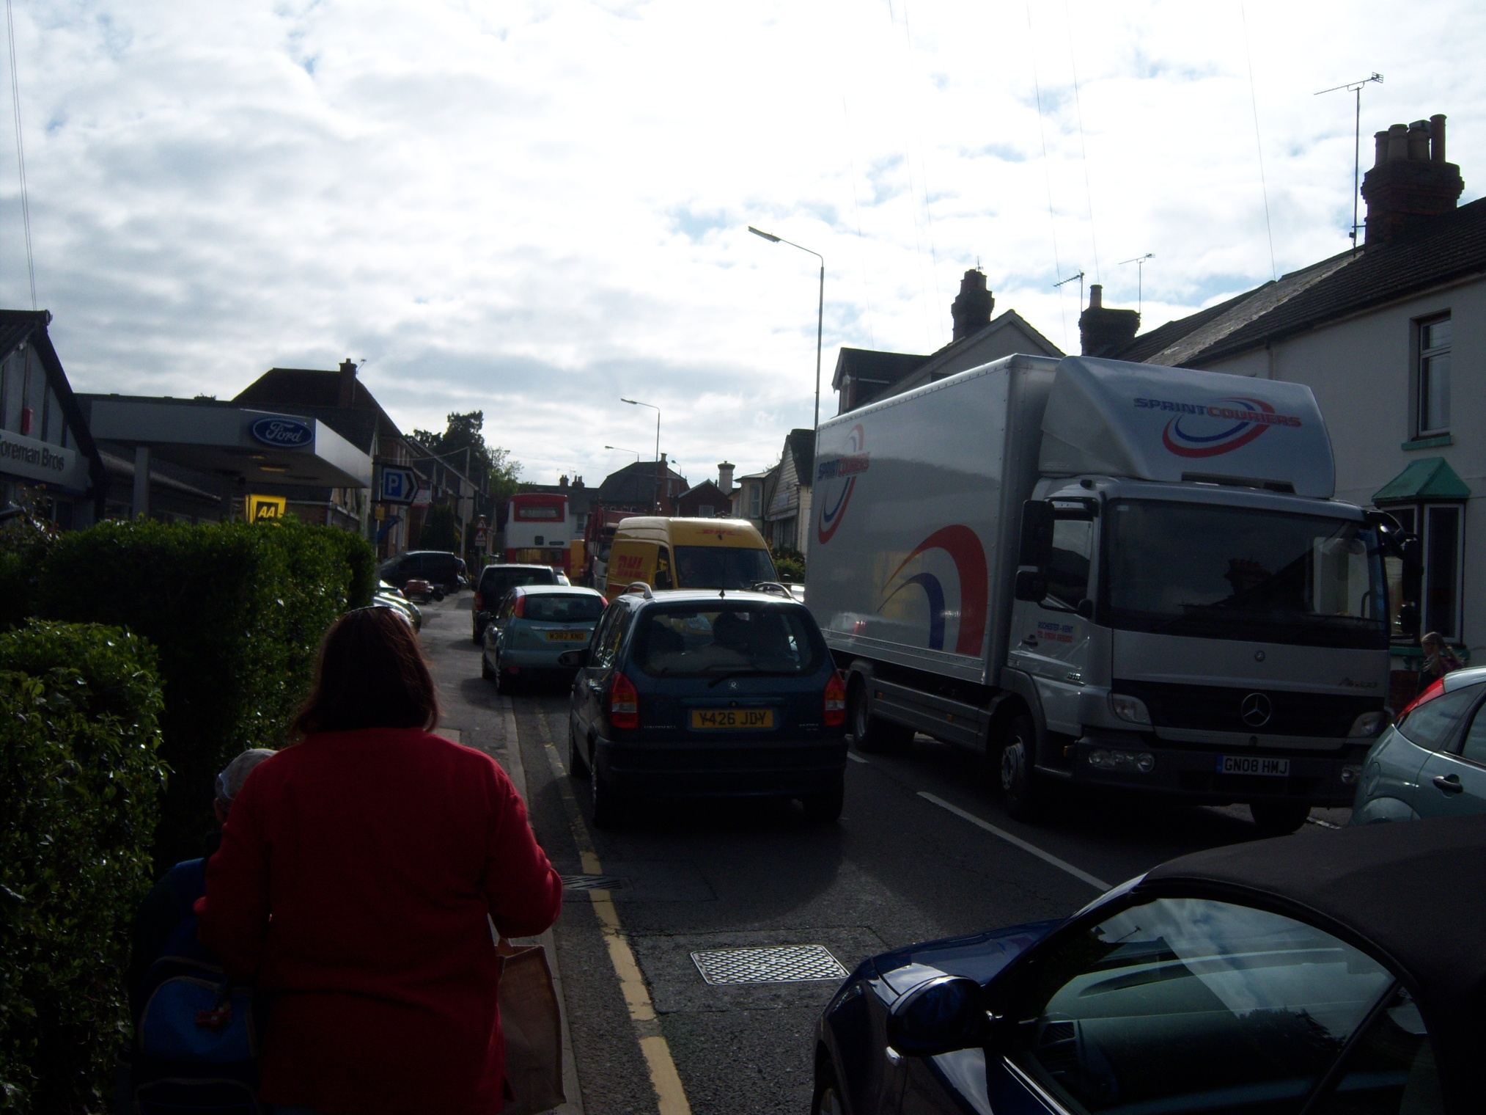

Slide 27
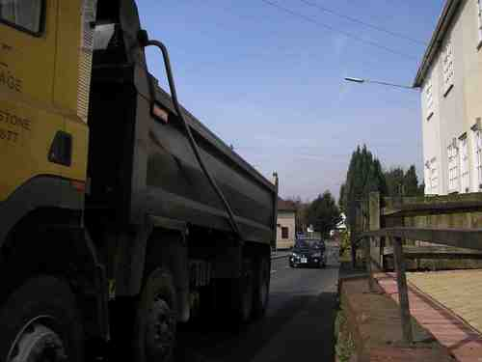
Air Quality
A 40 ton, five-axle lorry causes tens of thousands of times more air pollution damage than an average car. Source: Highways Agency
Children living on heavily trafficked streets are more likely to develop chronic respiratory problems. Source: Occupational and Environmental Medicine

Slide 28
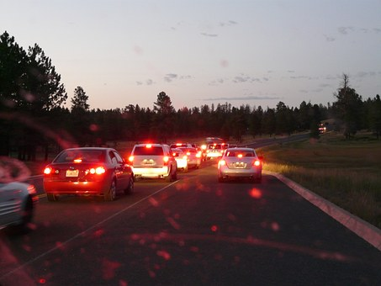

Slide 29
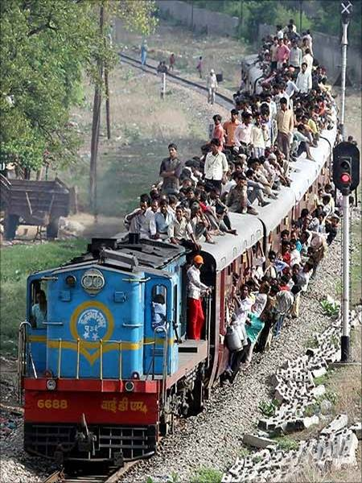

Slide 31
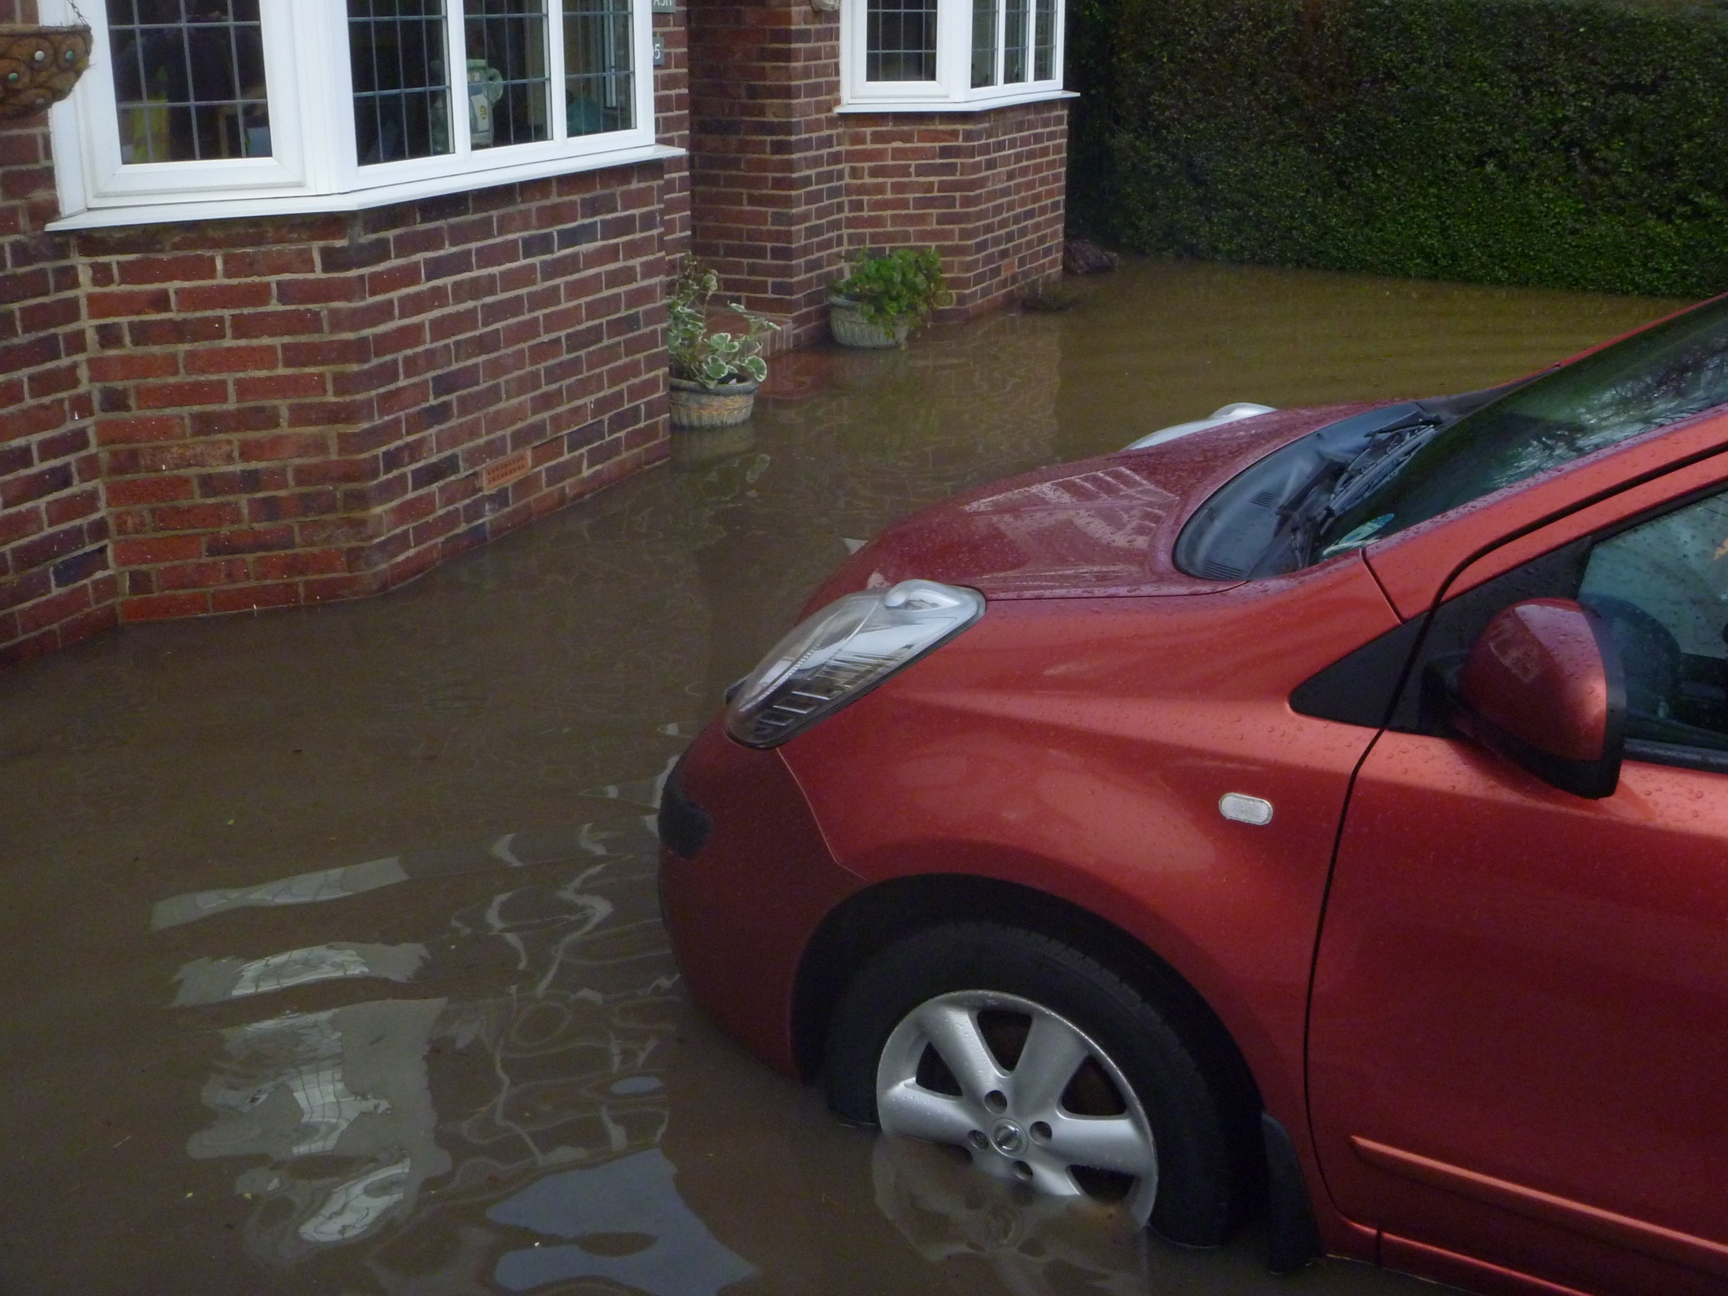

Slide 33
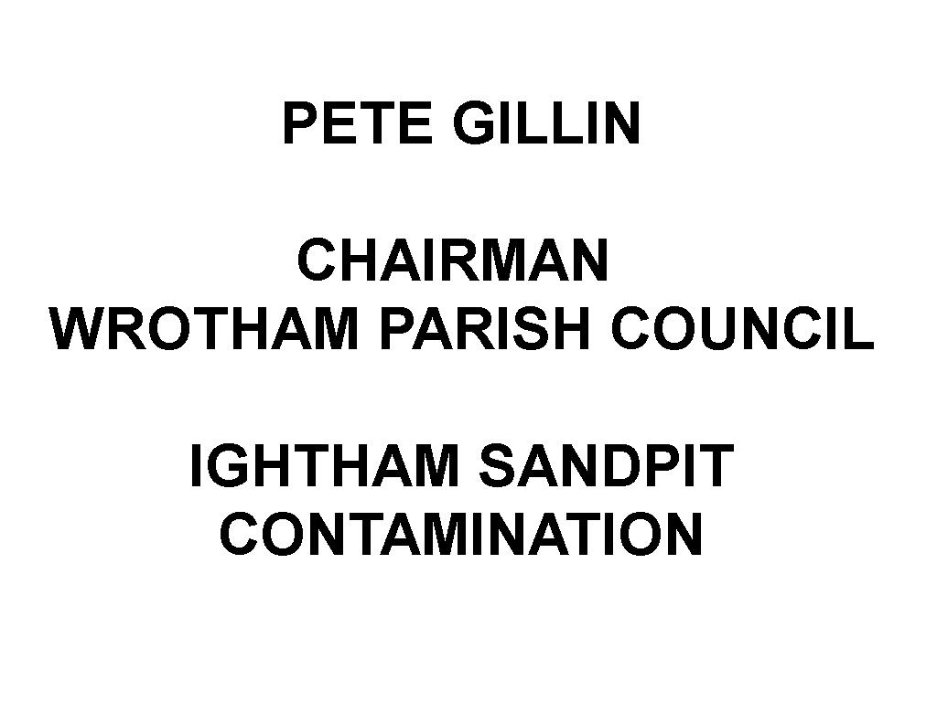

Slide 34
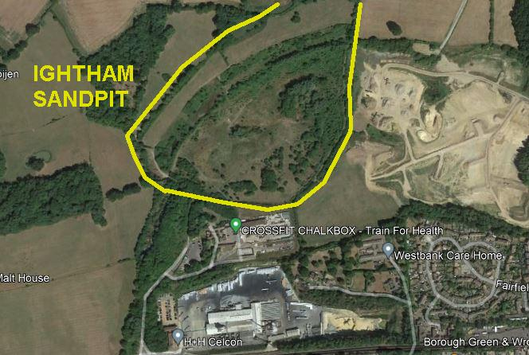

Slide 36
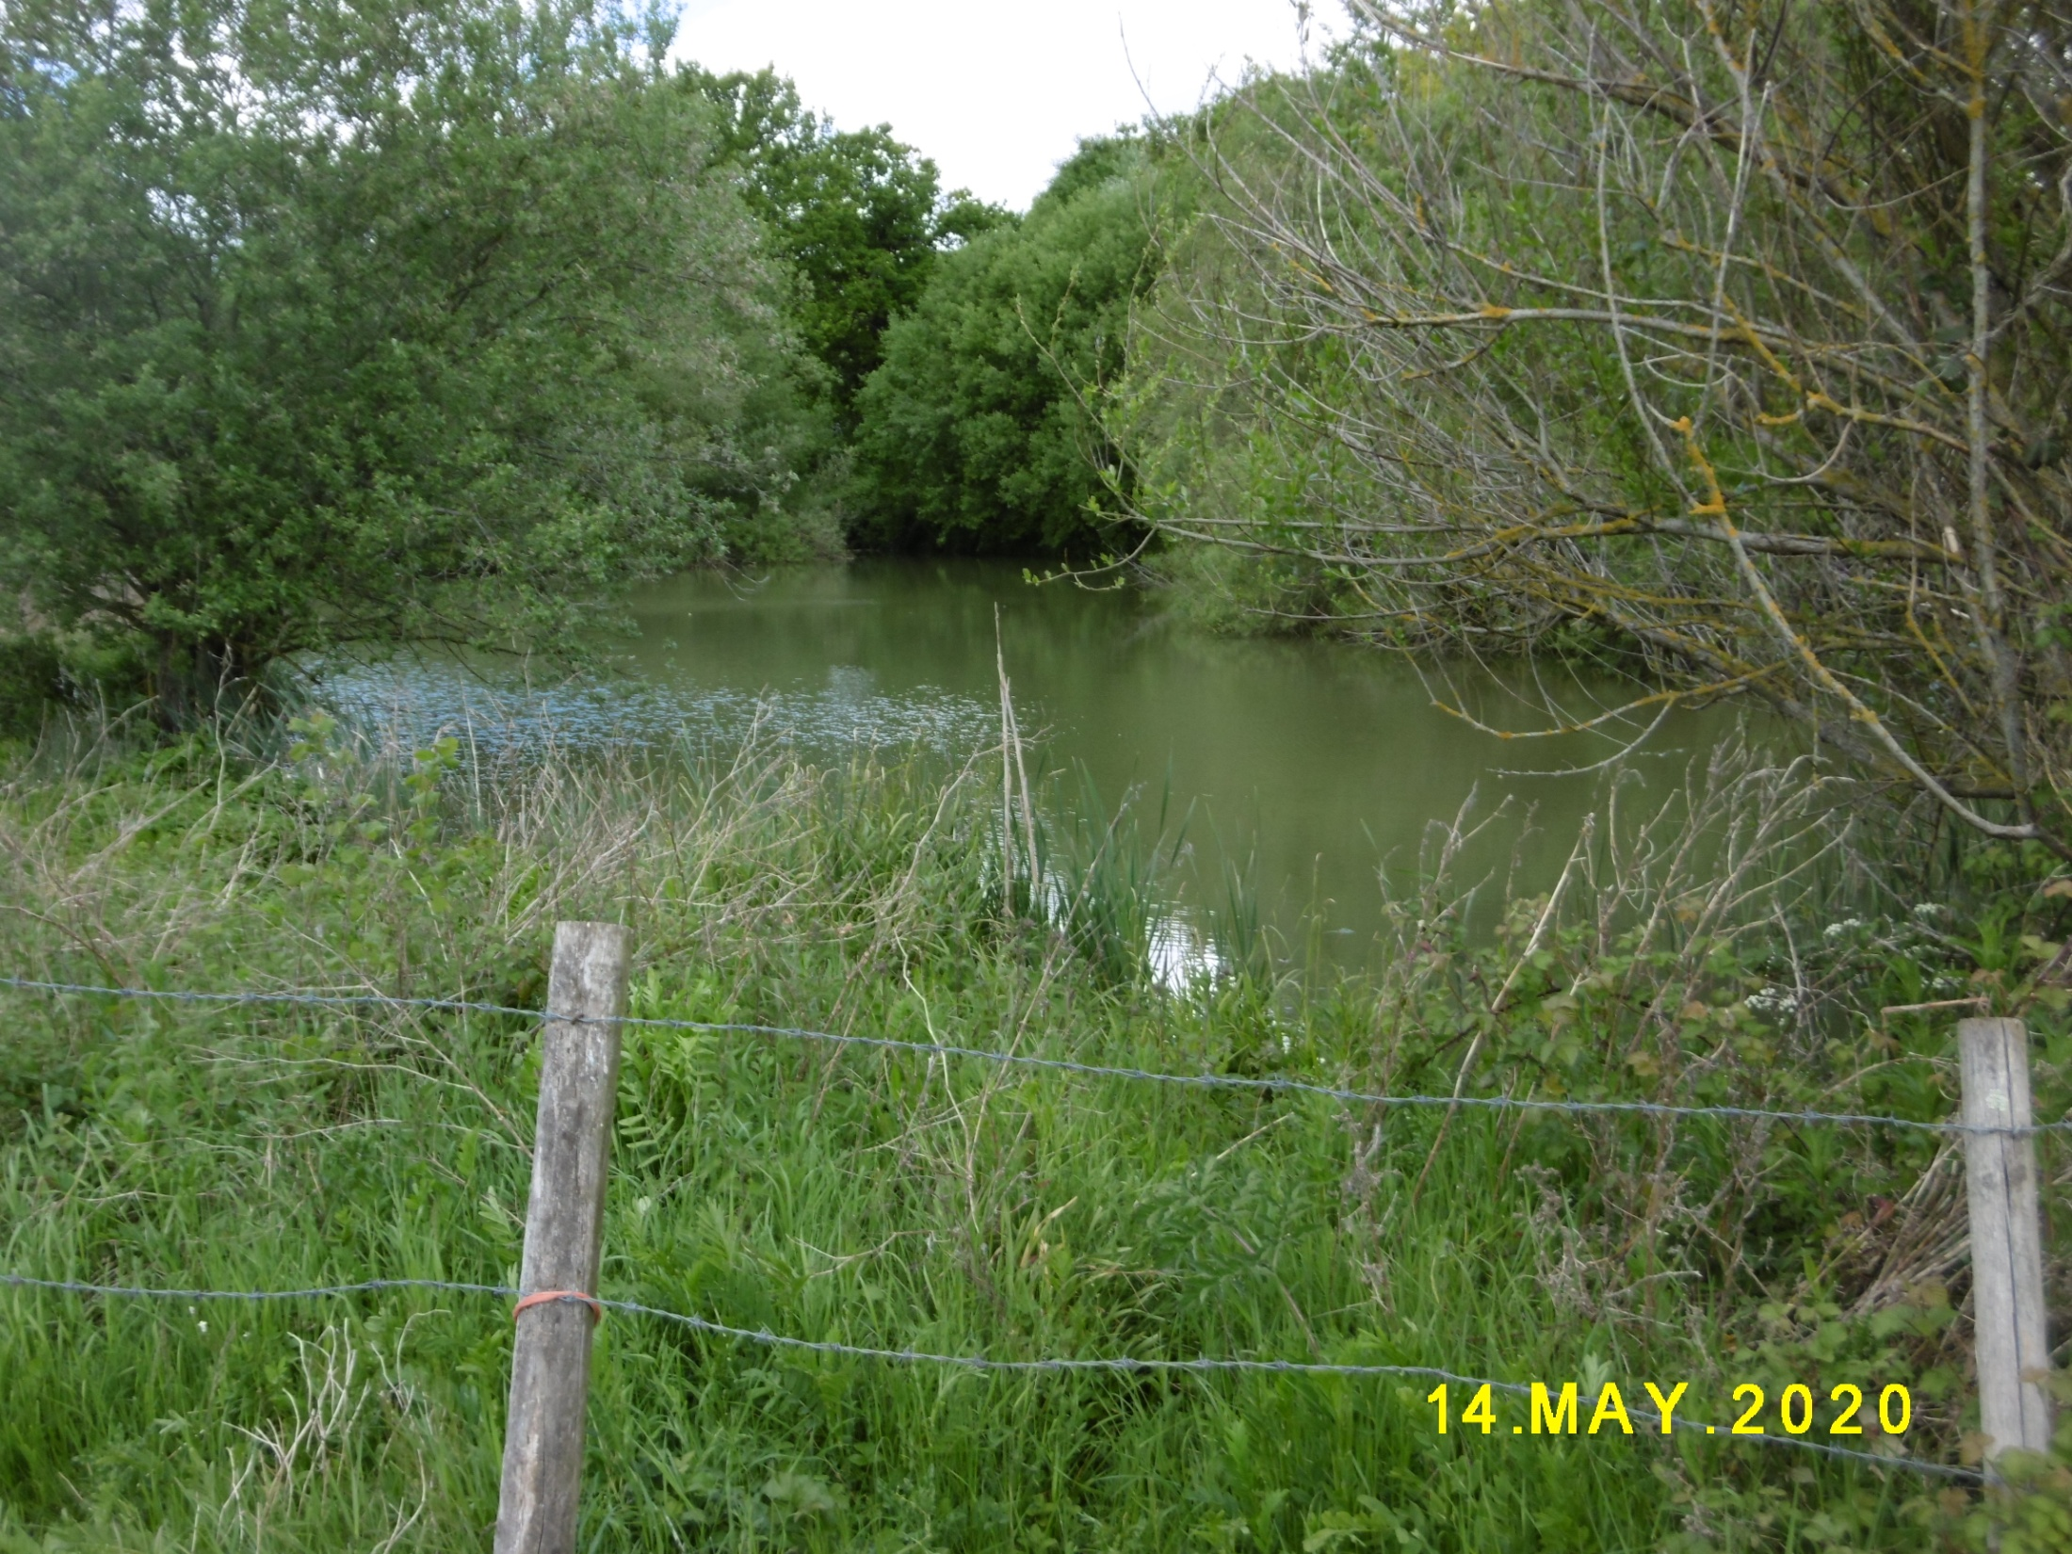

Slide 37
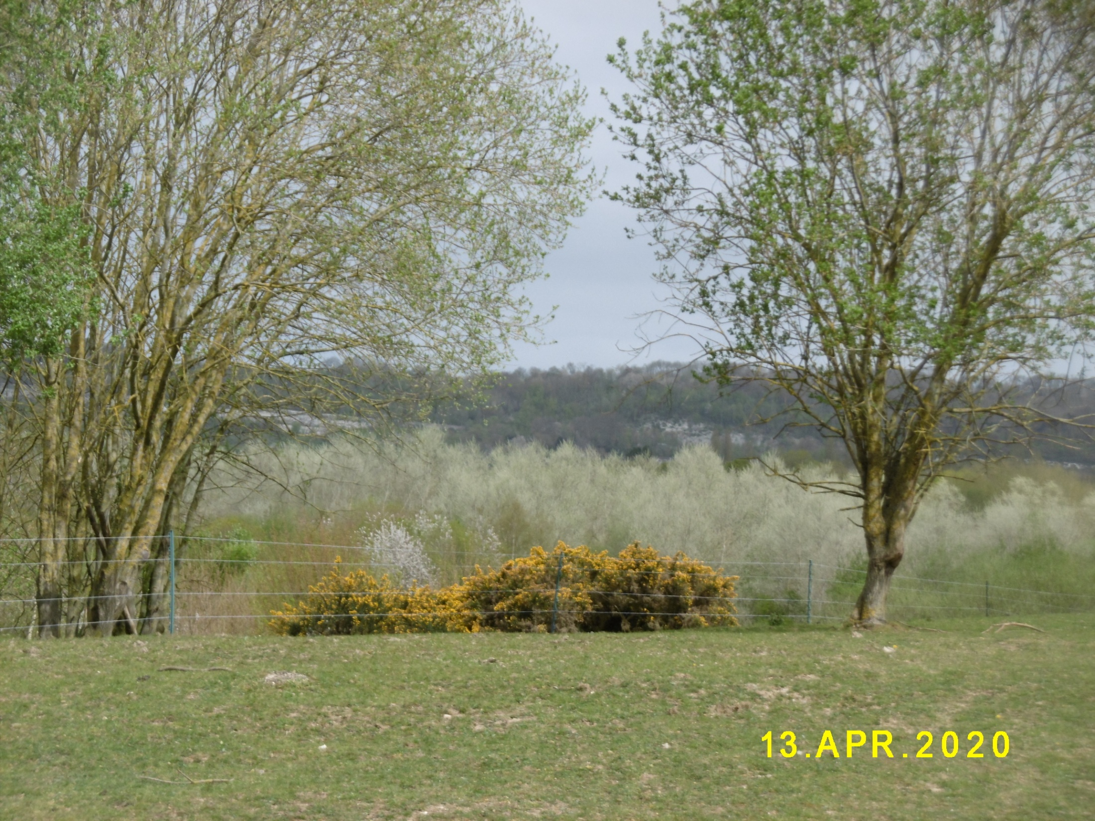

Slide 39
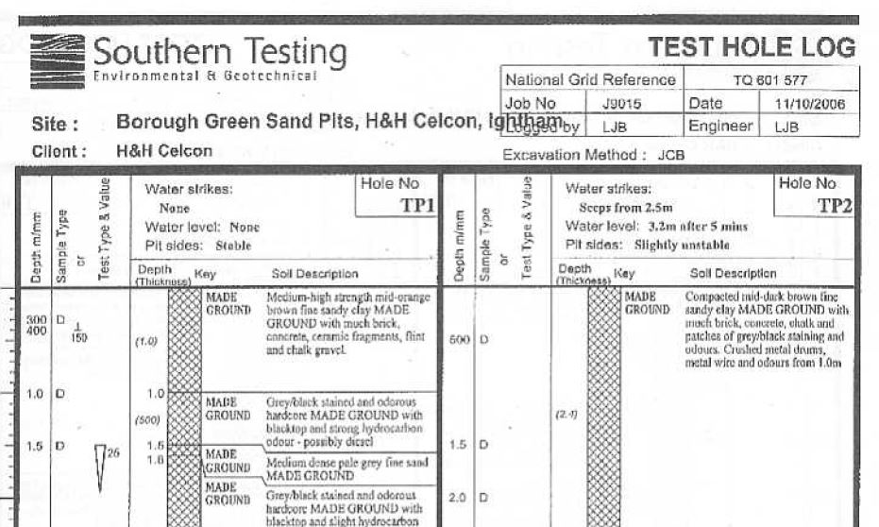

Slide 40
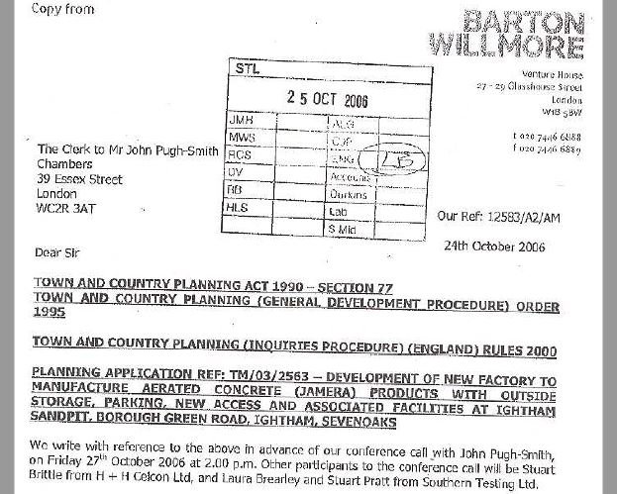

Slide 41
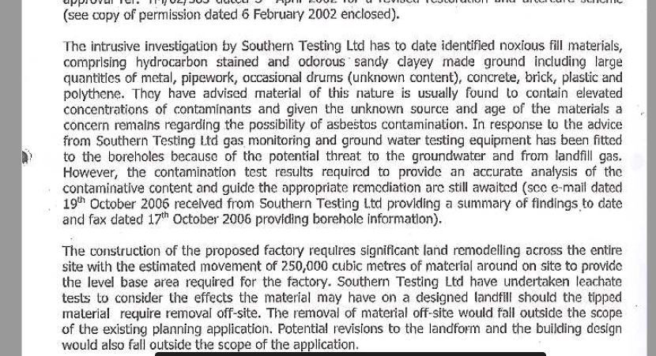

Slide 42
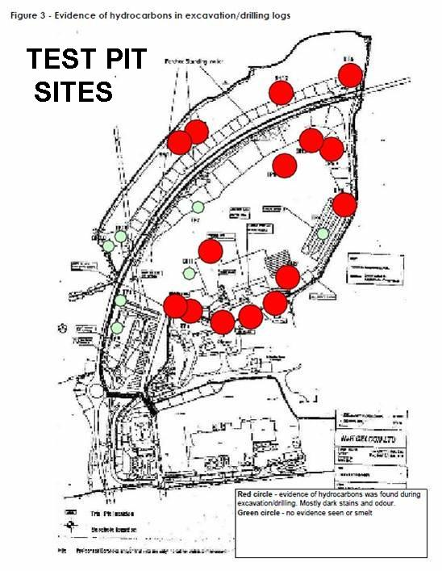

Slide 43
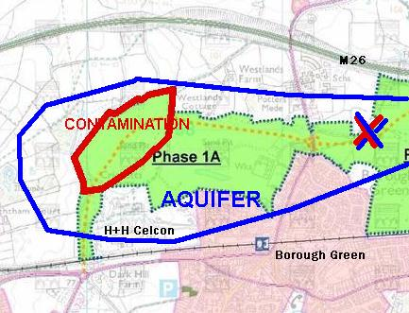

Slide 45
CONSULTATION RESPONSES
email to localplan@tmbc.gov.uk
Or write Local Plan Consultation
TMBC, Gibson Building, Kingshill,ME19 4LZ
Online www.tmbc.gov.uk/localplan
---------------------------------------------------------
www.boroughgreen.gov.uk/local-plan-2022
For simplified Questionnaires and advice

Slide 46
DEADLINE
THE CONSULTATION WILL RUN
UNTIL 3rd NOVEMBER
ANY RESPONSE SENT OUTSIDE THIS 6 WEEK
PERIOD WILL PROBABLY BE DISCARDED
It is essential to respond, even if you just email “No Greenbelt development”

