Slide 1
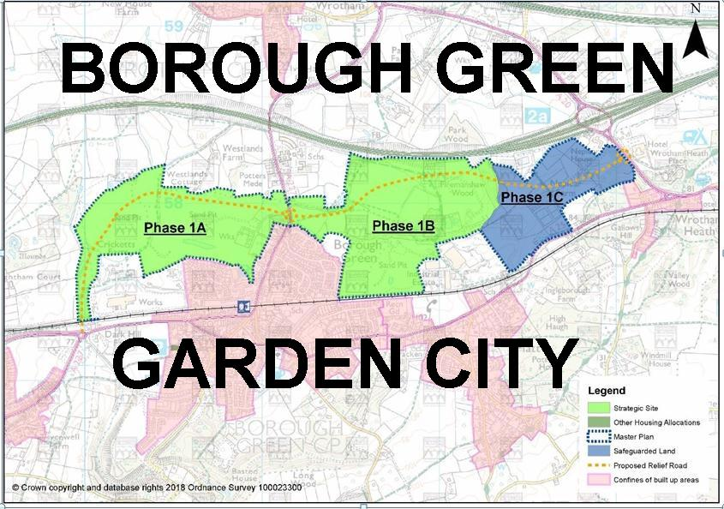

Slide 2
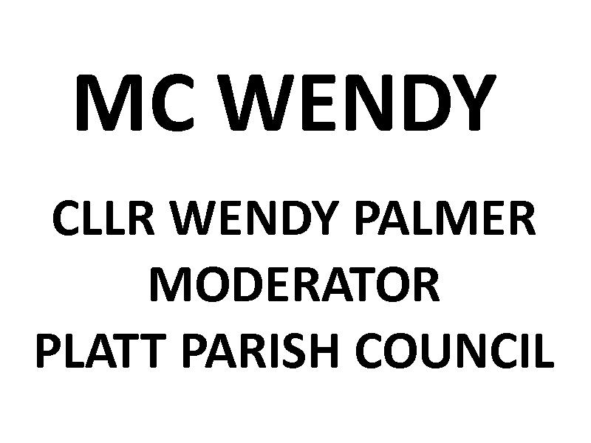

Slide 3
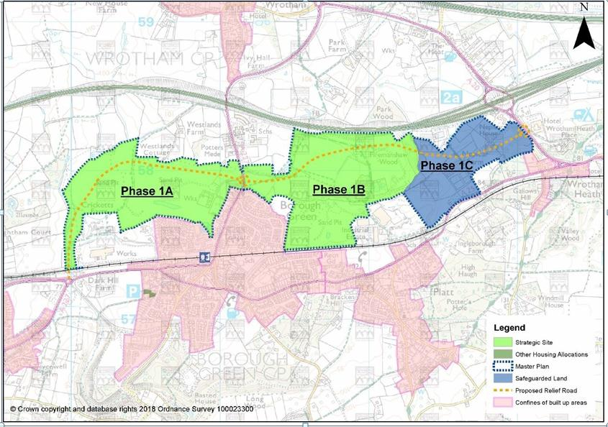

Slide 6
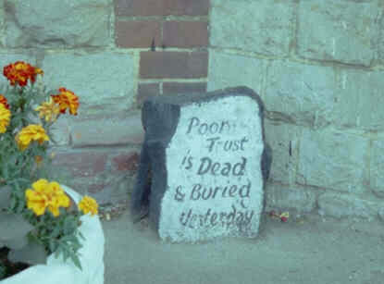

Slide 8
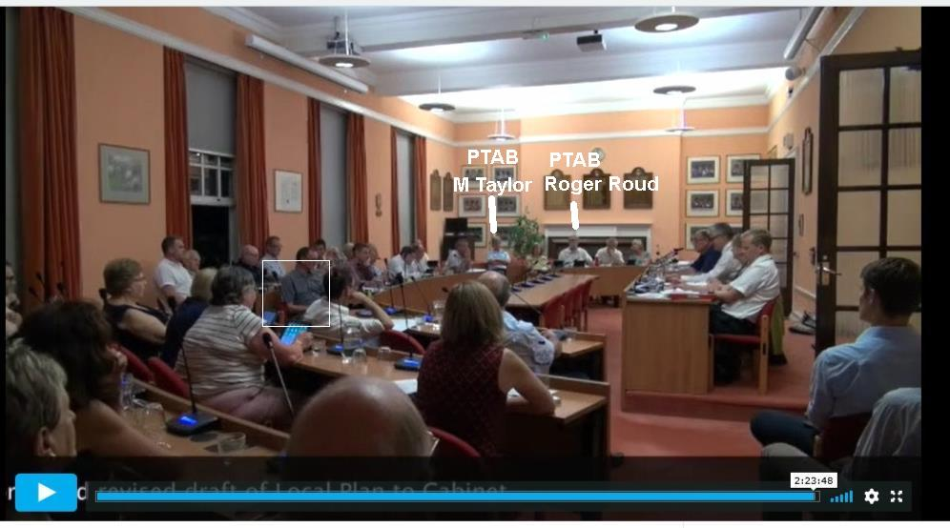

Slide 9
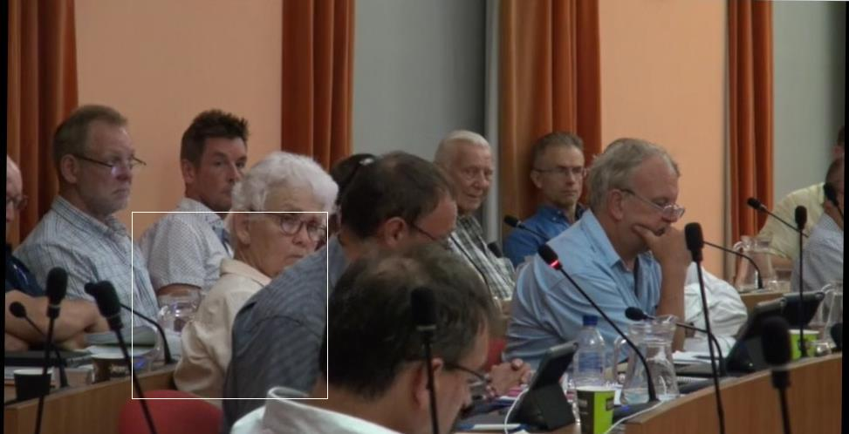

Slide 11
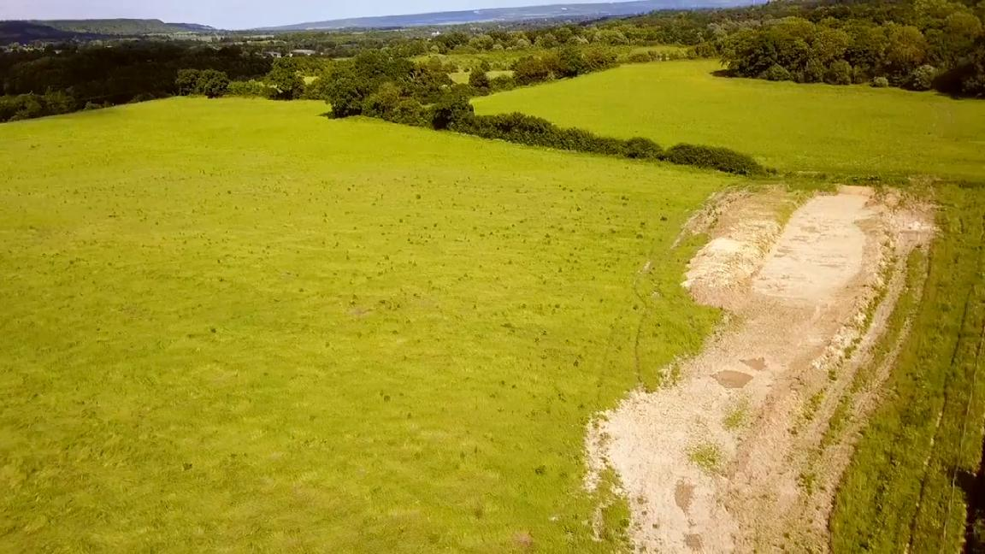

Slide 13
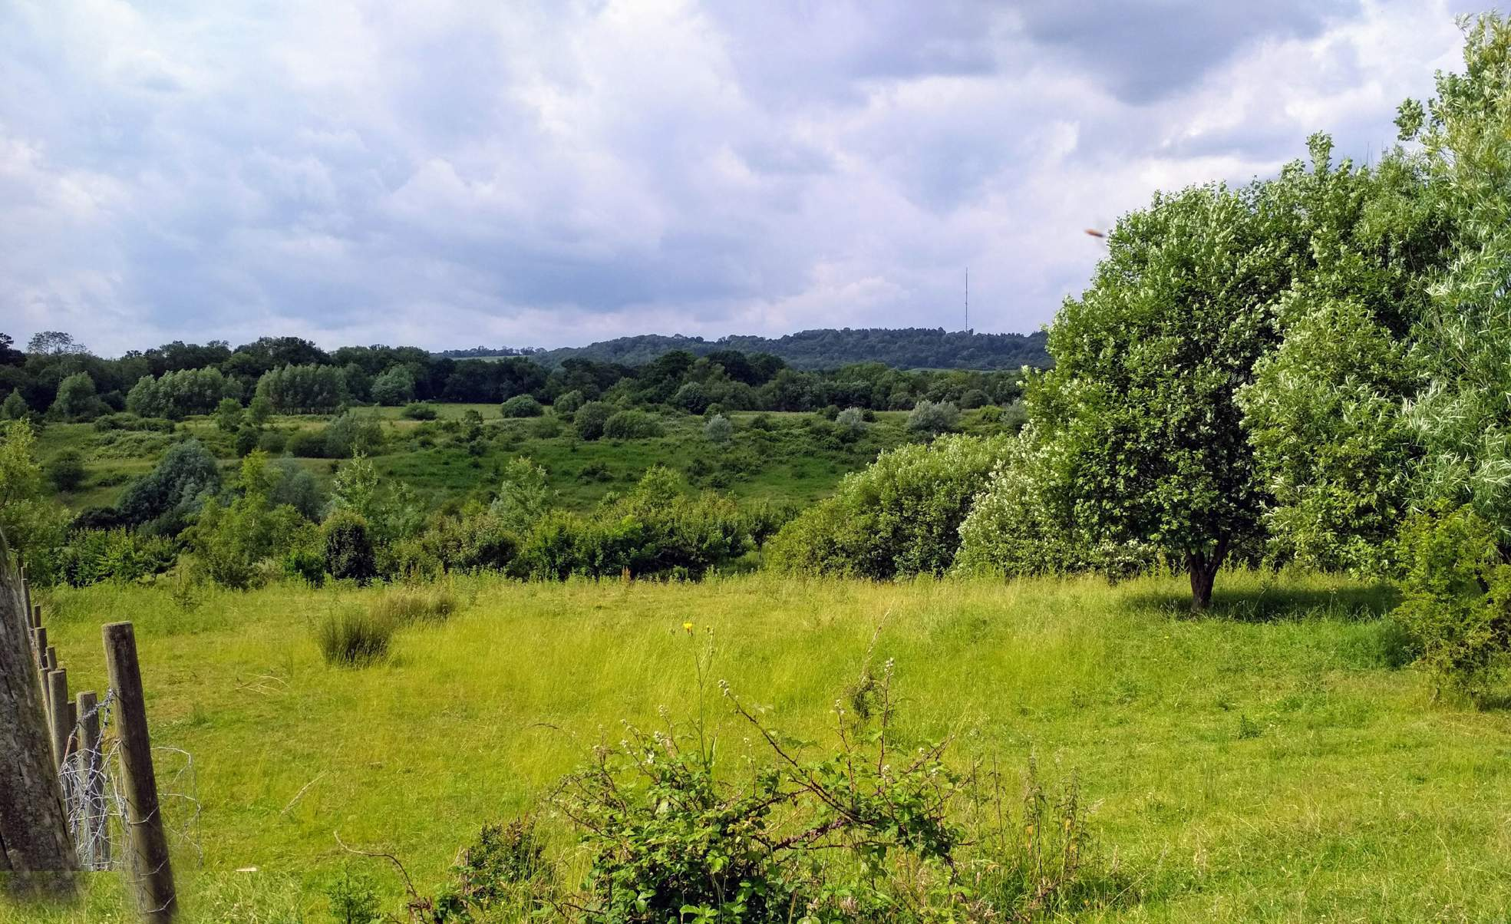

Slide 14
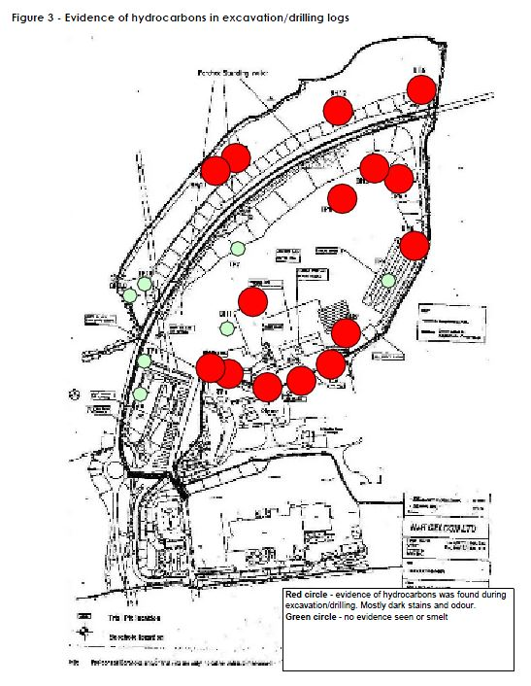

Slide 15
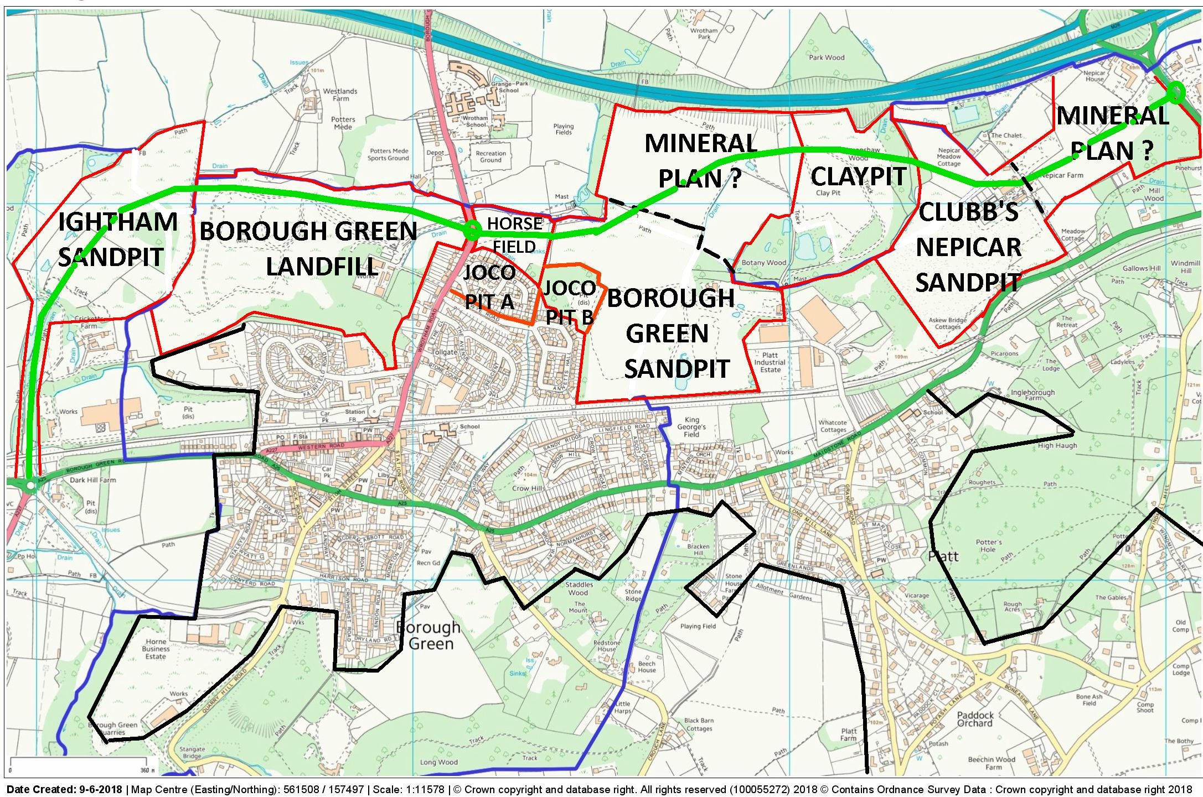

Slide 16
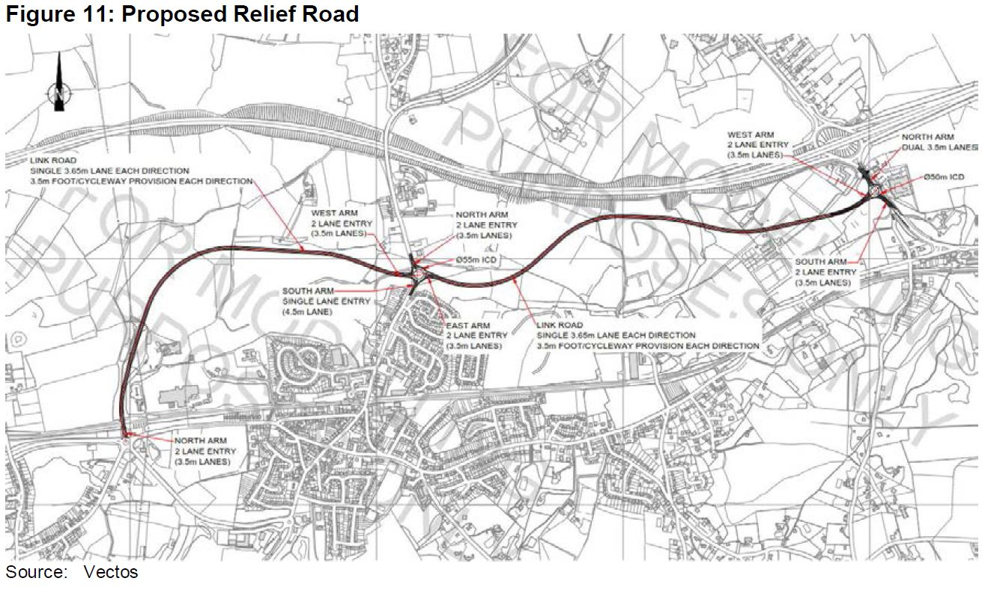

Slide 18
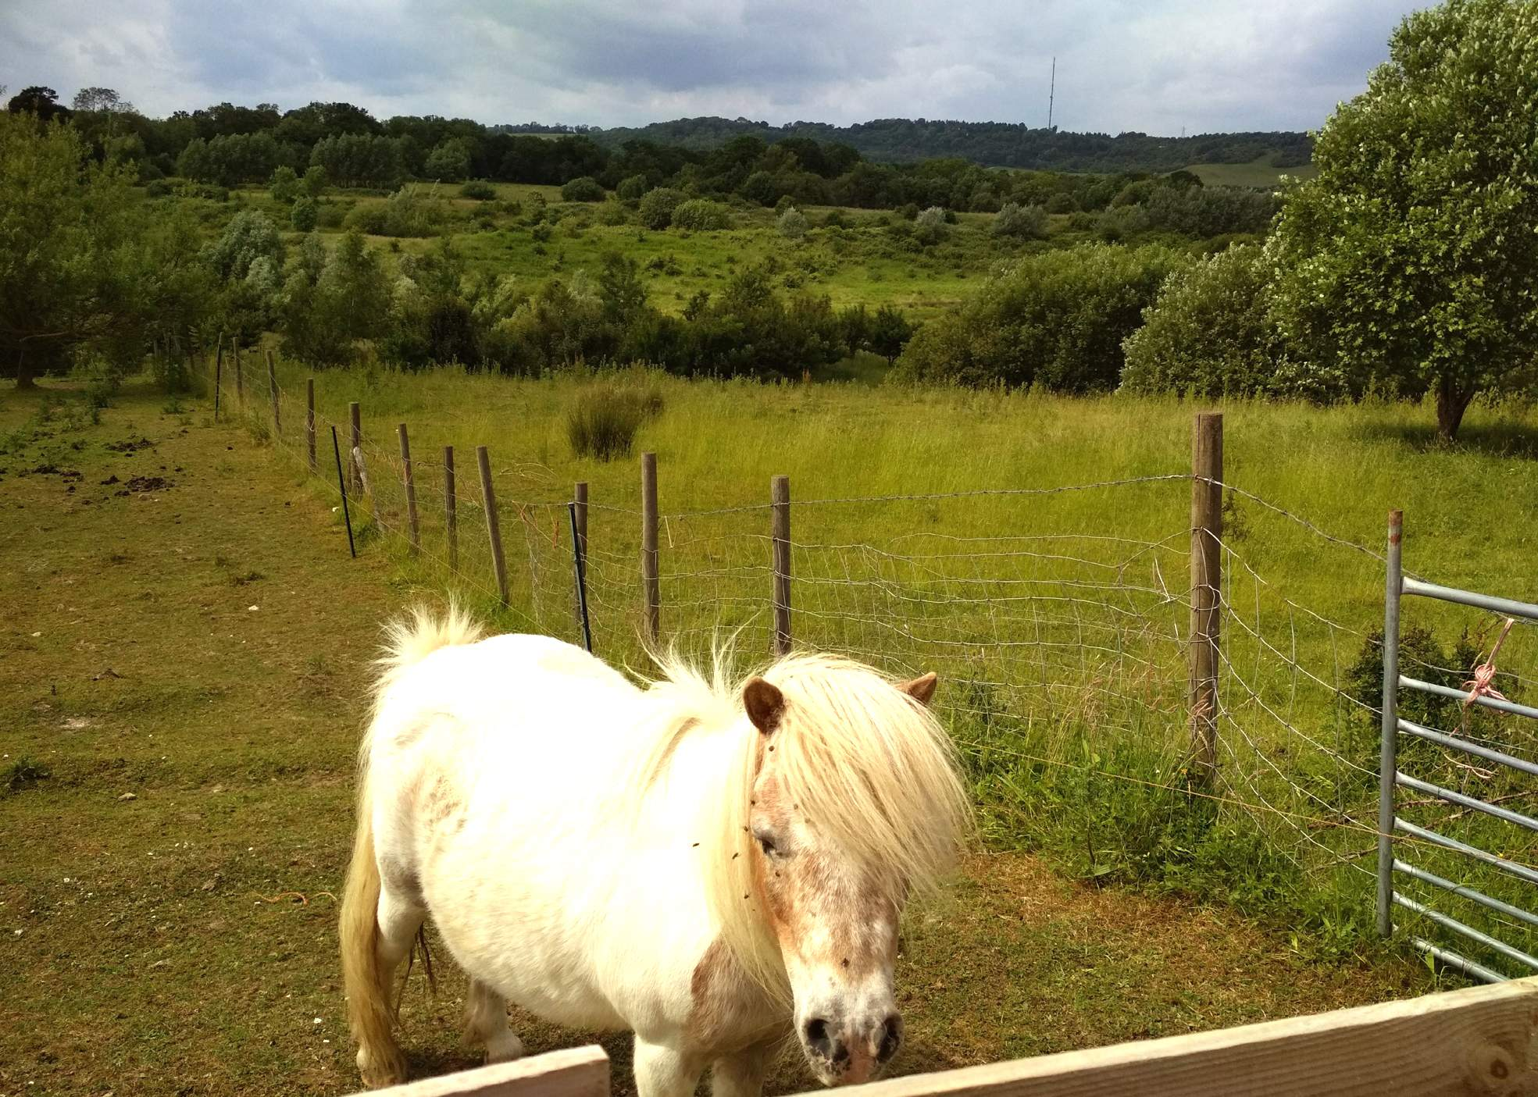

Slide 19
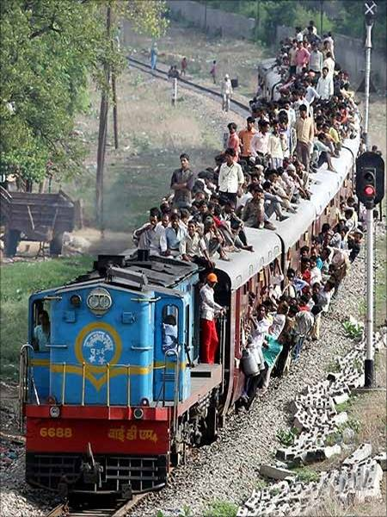

Slide 21
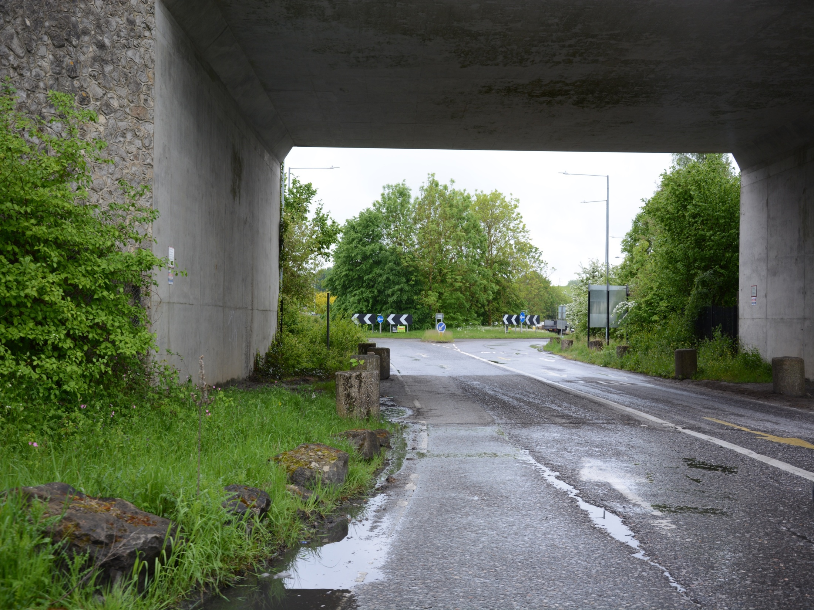
Housing estate Relief Road Dark Hill, Ightham (Western Gateway)

Slide 22
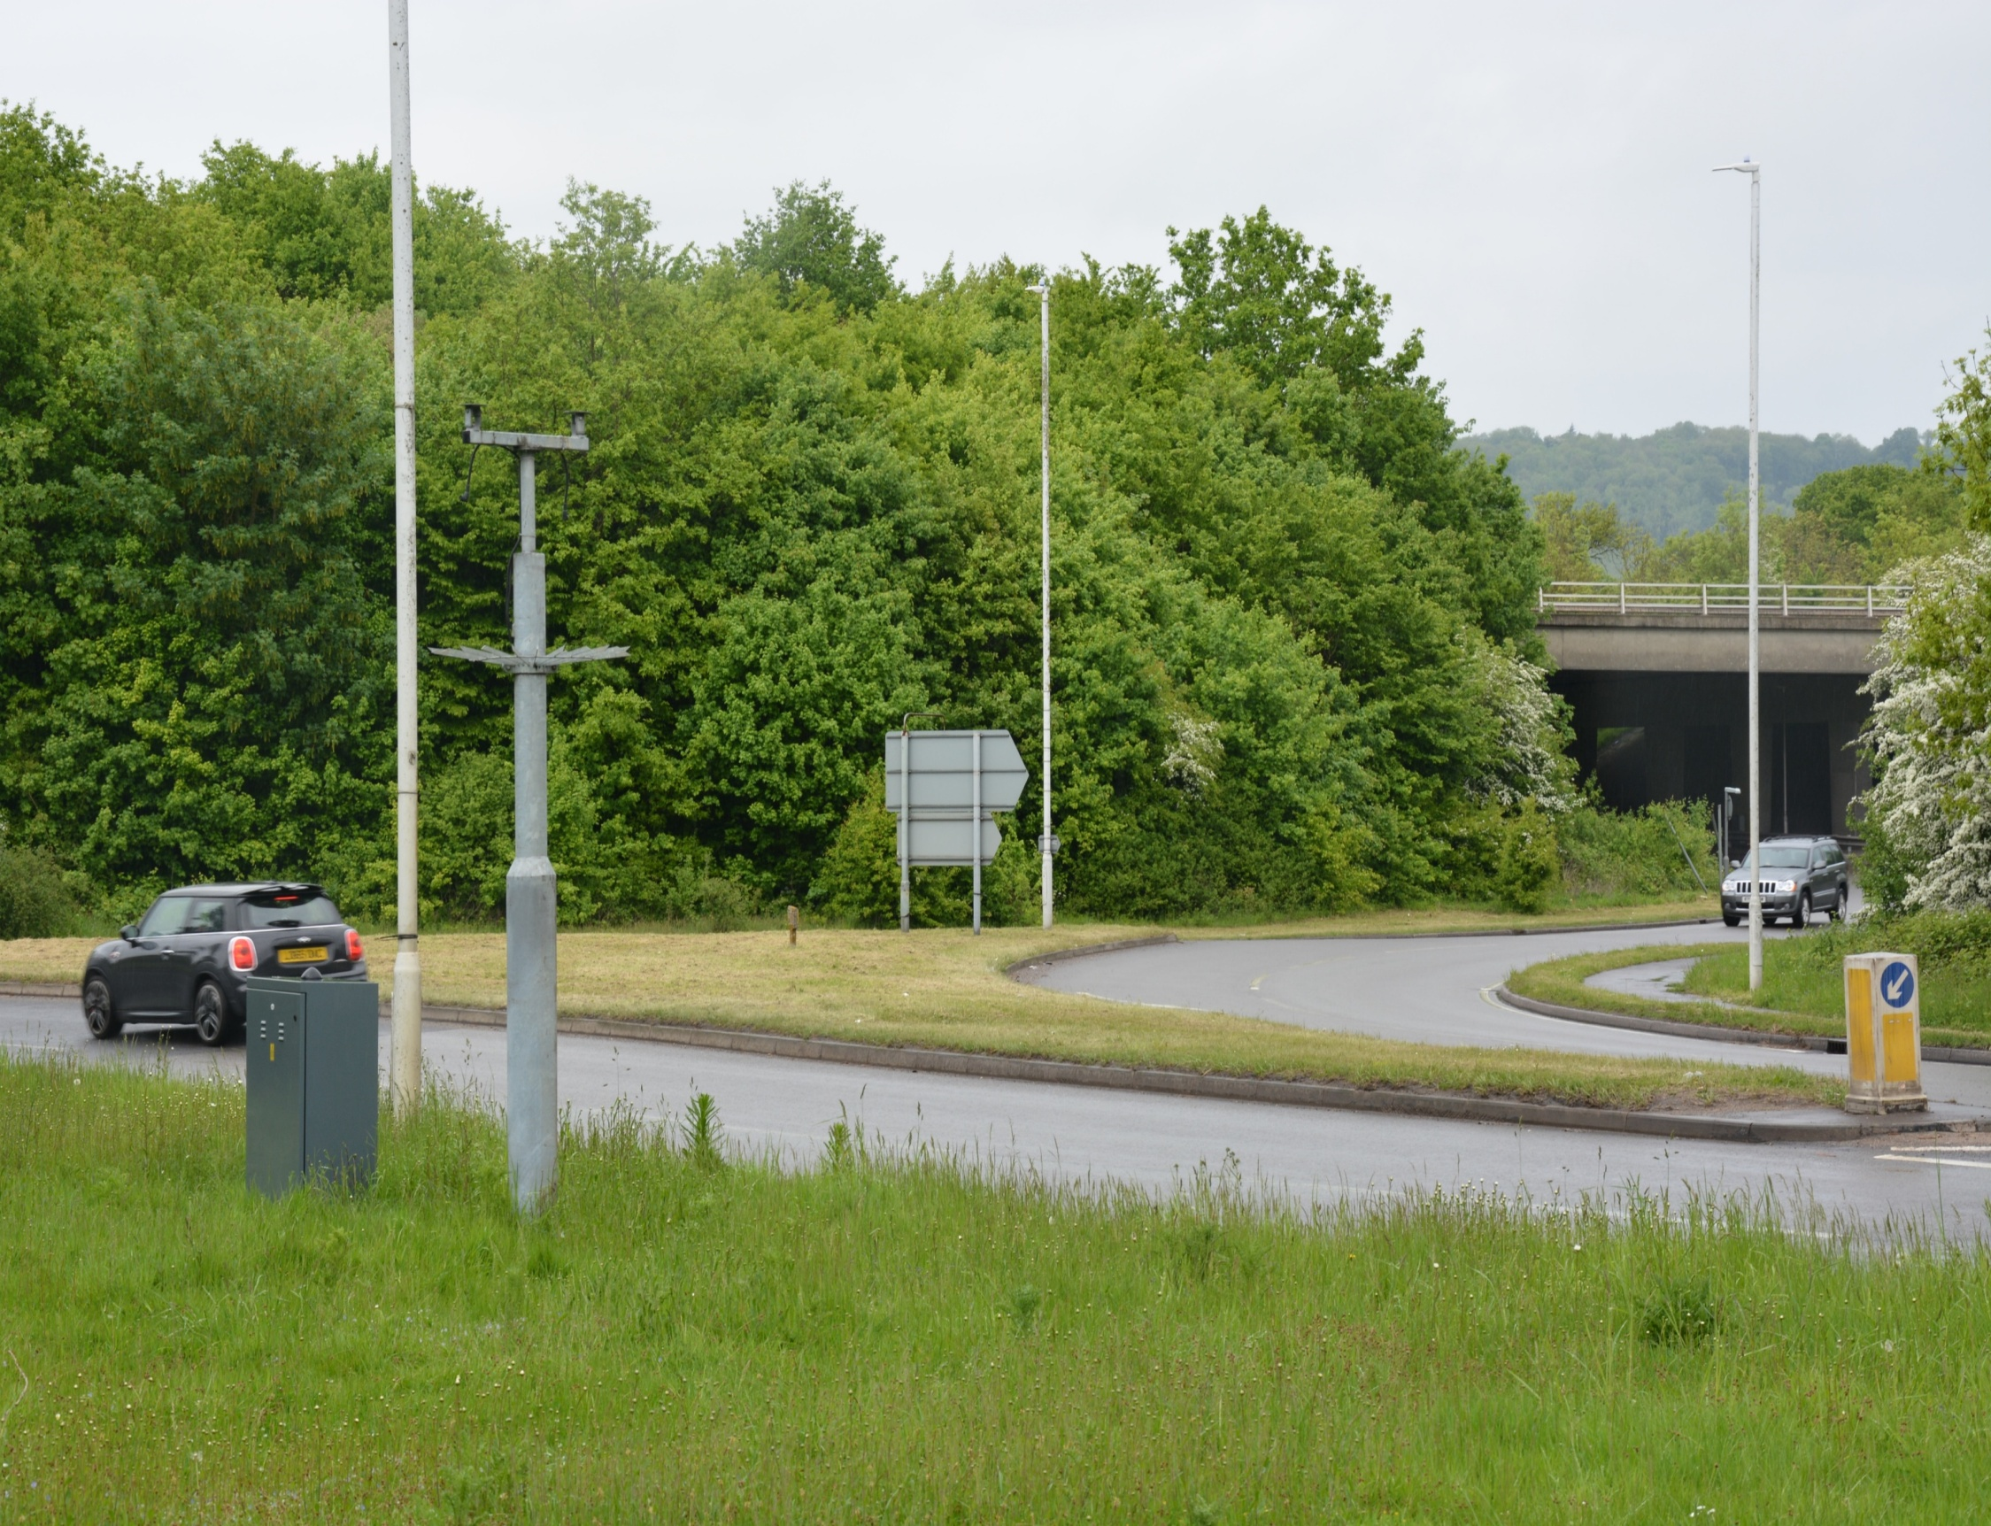
Traffic - Housing estate Relief Road Nepicar, Wrotham Heath, Roundabout (Eastern Gateway)
test

Slide 23
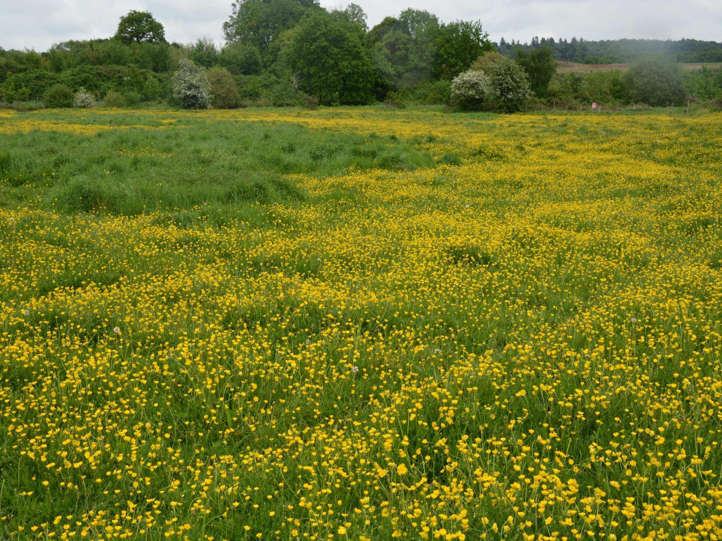
Housing estate Relief Road Three Way Meadows, Wrotham (Green Belt)

Slide 24
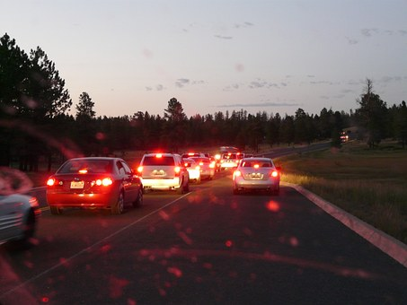
Air Pollution
A25 (18,000) – A227 (10,000) – M26 Air Quality Management Areas (AQMA)
3 Local Schools within 150m of 10,000 vehicles per day
Mass housing estate ‘Relief road’ for 8,000 new vehicles

Slide 25
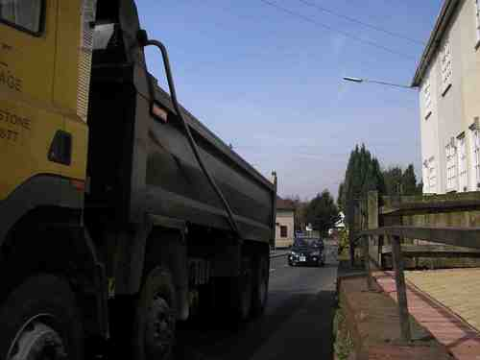
Air Quality
A 40 ton, five-axle lorry causes tens of thousands of times more air pollution damage than an average car. Source: Highways Agency
Children living on heavily trafficked streets are more likely to develop chronic respiratory problems. Source: Occupational and Environmental Medicine

Slide 26
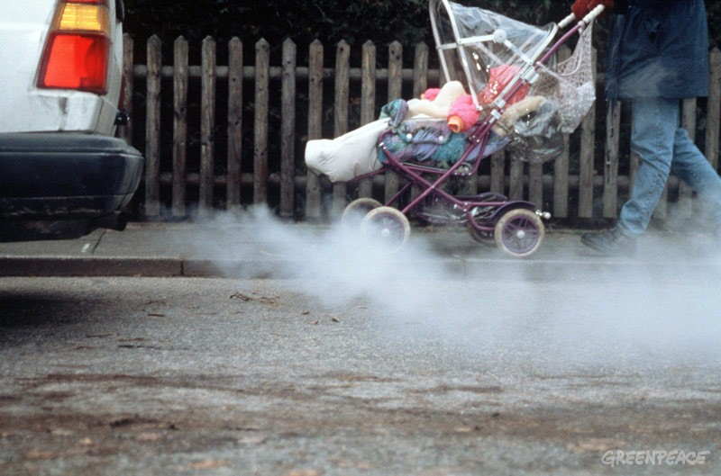
PM2.5 / PM10 NO2 Air pollution causes between 12,000 and 24,000 premature deaths each year. In Kent 2015 (1,050 deaths directly linked to killer levels of toxic pollution) Source: Committee on the Medical Effect of Air Pollutants

Slide 29
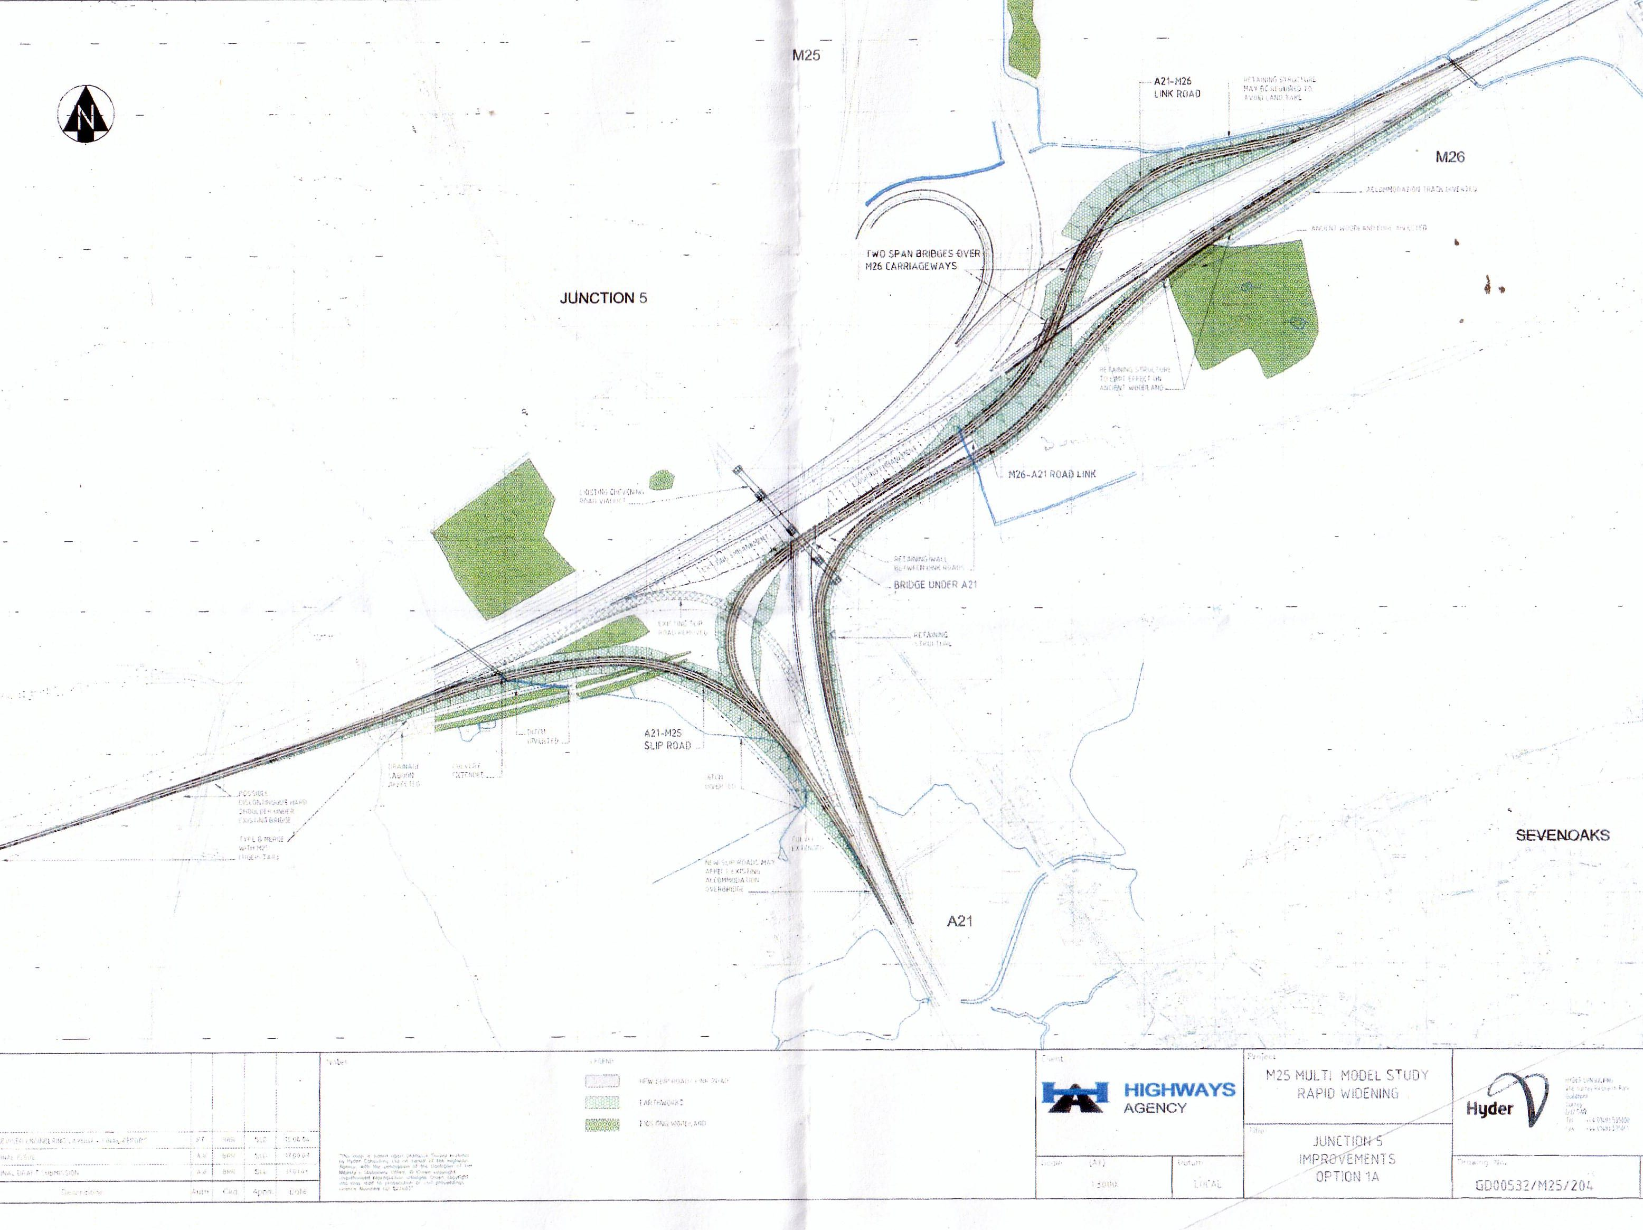
J5 Slip roads in the vicinity of M25 Junction 5 Sevenoaks
A traffic solution for all our West Kent Villages and not just the A227 / A25
The West Kent Bypass
www.j5-slips.org
Riverhead
Chevening
Brasted and Sundridge

Slide 30
Cllr ROBIN BETTS
WROTHAM PARISH COUNCIL
TMBC WARD MEMBER WROTHAM, IGHTHAM, AND STANSTED
DISPROPORTIONATE DEVELOPMENT

Slide 32
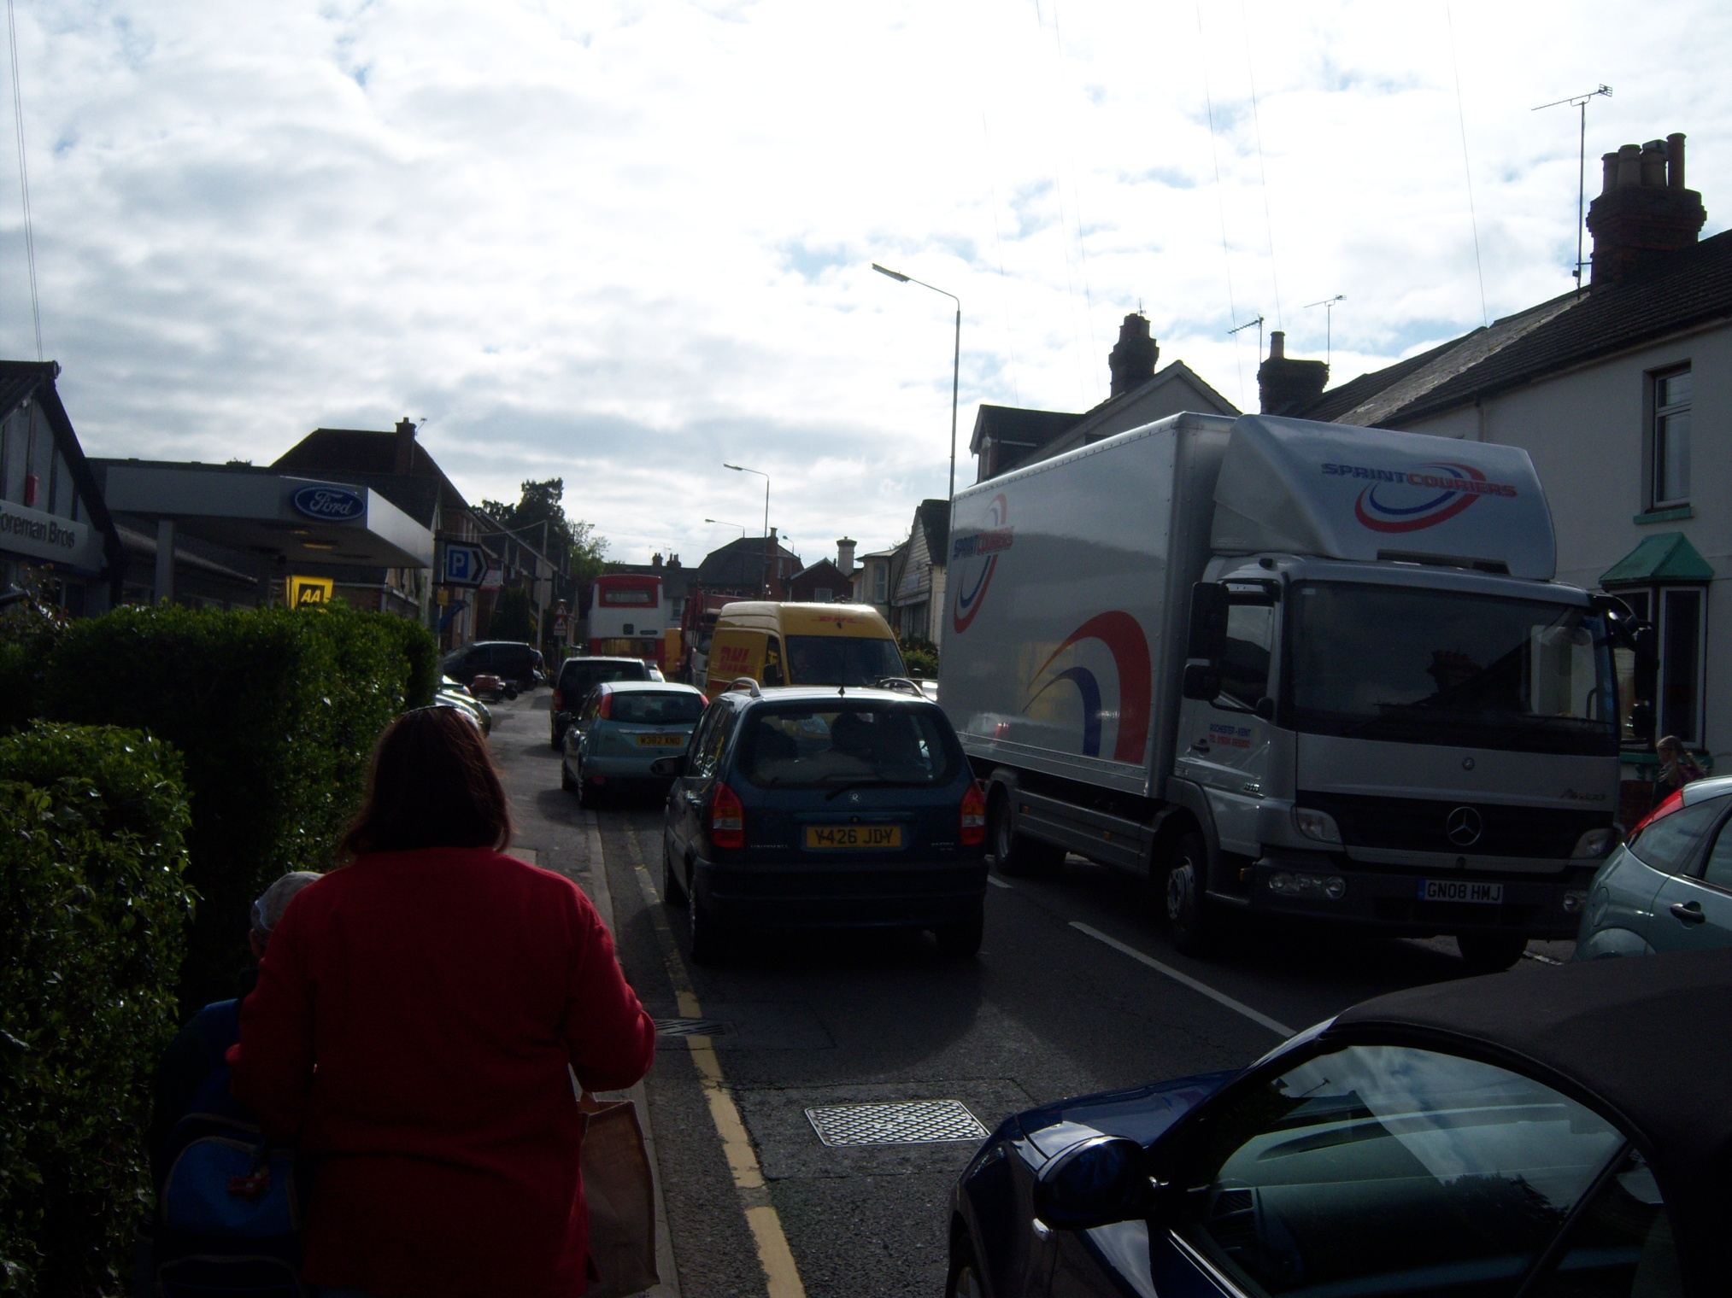

Slide 35
BULLET POINT LIST
The list of bullet point topics will be sent
to every house in your local Parish
Magazine during October and November,
it will be posted on Local Parish Websites,
and there are hard copies being
distributed tonight.

Slide 36
CONSULTATION RESPONSES
localplan@tmbc.gov.uk
Local Plan Consultation
Tonbridge & Malling Borough Council
Gibson Building
Kingshill, West Malling.
ME19 4LZ

Slide 37
DEADLINE
THE CONSULTATION WILL RUN FROM
1st OCTOBER UNTIL 12th NOVEMBER
ANY RESPONSE SENT OUTSIDE THIS 6 WEEK
PERIOD WILL PROBABLY BE DISCARDED

